Slide 1
Food Security – An issue for Switzerland?
WTI Brown Bag Lunch
Bernard Lehmann, Federal Office for Agriculture

Slide 2
Contents
Global developments / Future challenges
The concept of food security – and ways to increase global food security
The Swiss Food System in a global context
What are the obstacles of a stronger engagement of Switzerland

Slide 3
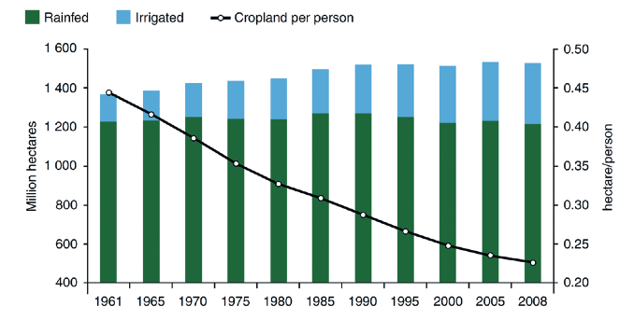
Global developments / Future challenges
Agricultural area per capita – dramatic decrease
Quelle: ISAA Potsdam (2012) , Global Soil Forum
Best soils are already used by agriculture
Notes:
Example for a future challenge! Grafik zeigt Land das genutzt wird, nicht Potential!
-Soil is a very important resource in food production. The global area of cultivated land has grown by a net 159 Mha since 1961. This increase, however, includes a larger area of land newly brought into cultivation, while over the same period previously cultivated lands have come out of production.
-All of the net increase in cultivated area over the last 50 years is attributable to a net increase in irrigated cropping, with land under rainfed systems showing a very slight decline. Irrigated area more than doubled over the period, and the number of hectares needed to feed one person has reduced dramatically from 0.45 to 0.22 ha per person (FAO, 2010b).
-This shows that most of the land, that is well suitable for food production is already in use by the farmers. Production has to be increased on land in areas where production more difficult since there isn’t enough rainwater.
This increase in irrigated land also increases the importance of water for irrigation and subsequently can lead to conflicts about water use…
-This problem becomes more important since the global resources for production (mainly soil but also water, biodiversity) are still under pressure, threatening food security in the different regions…

Slide 4
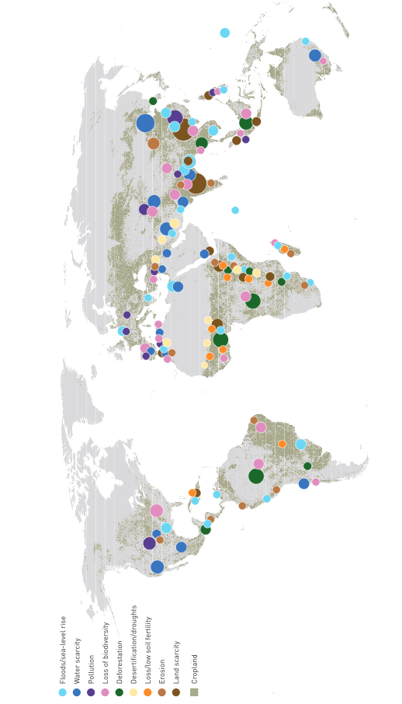
Global developments / Future challenges
Resources for production under pressure – various causes
Landwirtschaftsland – eine bedrohte Ressource
Quelle: The State of the world’s land and water resources for food and agriculture, FAO (2011)
Notes:
-The Figure gives a schematic overview of the global distribution of risks associated with main agricultural production systems. In conclusion, a substantial share of the world’s land and water resources, and their ecological integrity, are under stress from increasing demand and unsustainable agricultural practices.
-Further demand from agriculture for example driven by an increasing population or by other sectors, will add stress and threaten the future production capacity.
-Especially climate change will negatively affect farming systems, in the semi-arid and subtropical areas in particular, impacting water resources and irrigation systems in a number of ways, and requiring major adaptation efforts in most cases. For example deltas and coastal areas will be doubly at risk of flooding from sea-level rise and more variable wet-season rainfall. This development will – not only but mainly affect agriculture and food security in southern/developing regions.

Slide 5
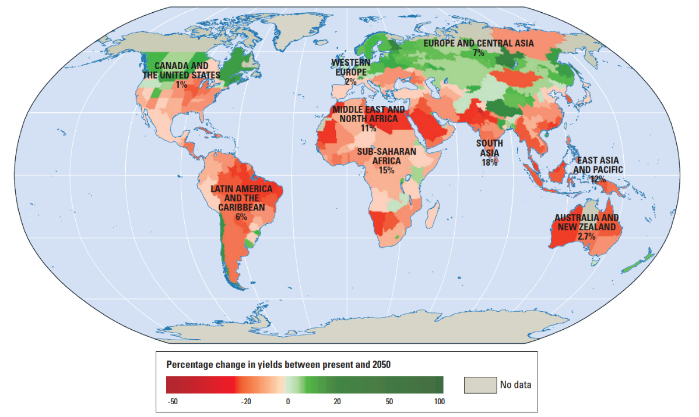
Global developments / Future challenges Greenhouse gases: Emissions and Impact
GHG Emissions
Impact of Climate Change
Source: World Meteorological Organization 2015
Quelle: World Bank (2010): World development Report 2010: Sources: Müller and others 2009; World Bank 2008c.
Notes:
Grafik zeigt Einfluss einer Erhöhung der Temperatur von
-As mentioned before climate change will be a challenge for agriculture
-The impact of climate change is not evenly spread on the world. Climate change will have a negative impact on agricultural production mainly in the south. For example in Africa climate change will reduce yields in average by 15%. Certainly with the use of adequate management practices this negative impact can be reduced. But adaptation will demand for investments in research and infrastructure. Money that hardly will be available. So there will still be reduction in production.
-In contrary climate change will have a positive impact on yields in the northern hemisphere. Also in Switzerland.
-Impact is mainly opposite to the source of the problem. The main emitters of greenhouse gases are located in the northern hemisphere, where agriculture in average will profit from climate change
-To improve the situation developed countries in the northern hemisphere would have to make a step towards the south by reducing their emissions. But such a step could reduce economic growth in these countries. Such costs they currently don’t want to accept. So they southern countries will have to bear the consequences.
-Northern countries probable don’t want to accept the costs of climate mitigation since - in the worst case - they also can afford adaptation measures because of their high economic power (next slide)

Slide 6
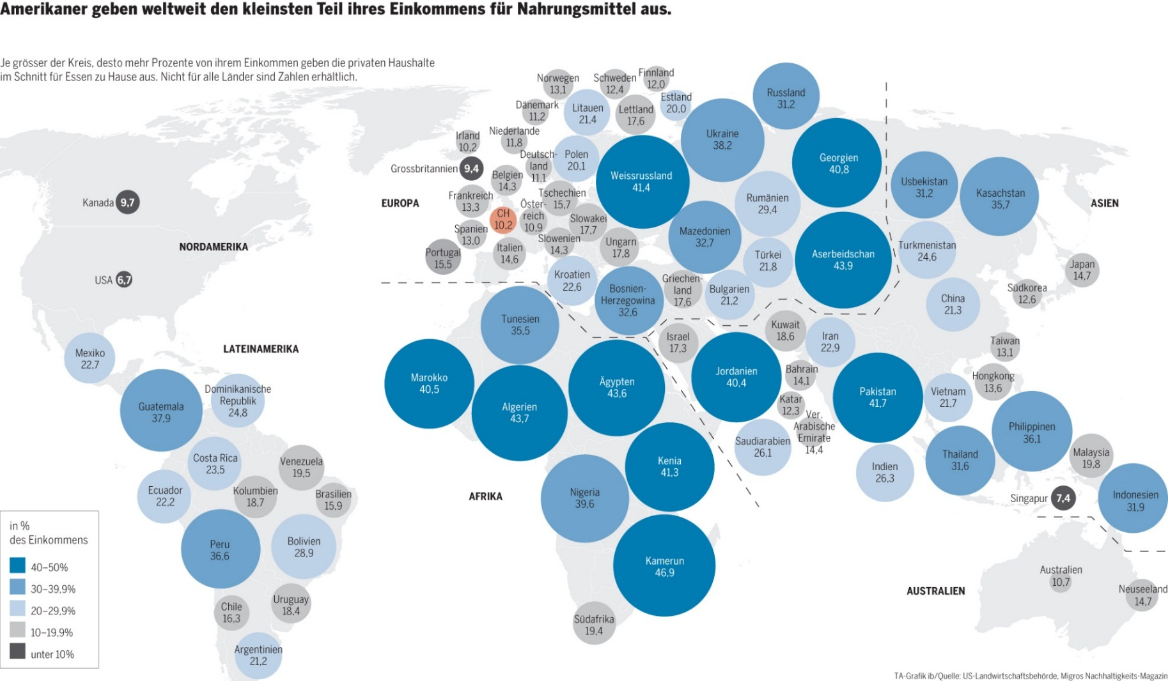
Global developments / Future challenges Who cannot afford spending more for food
% of income spent for food
Quelle: Tagesanzeiger online: http://files.newsnetz.ch/upload//2/7/27234.jpg, 16.07.2013
Notes:
-As mentioned before climate change will have a negative impact on agricultural production in southern countries. These are the countries, where people already today spend a large share of their income for food. In contrary people in northern hemisphere only spend a smaller share of their income for food
-If climate change has a negative impact on food production it is very likely that people in the developed countries will have the resources to fulfil their needs on the international markets. In contrary to the southern people who are not responsible for the situation but suffer most because they have not enough purchasing power in competition with the northern hemisphere.
-Globally climate change therefore will have a negative impact on food security.
-The same may be true by other adaptation measures that cannot be afforded by the southern countries.
-Climate change is only one aspect that has an impact on food security on a global scale. But this mechanism that countries in the northern hemisphere – including Switzerland – focus their policies solely on their own actors and do not take into account their impact on other regions of the world is very similar for agricultural policy than for climate change. As will be shown on the next slides.

Slide 7
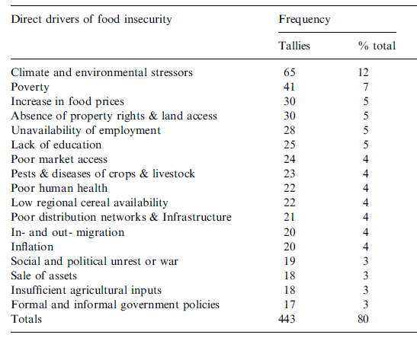
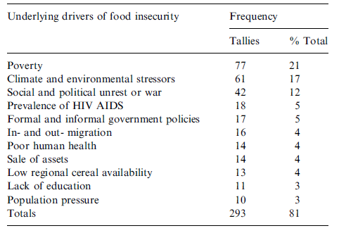
Food security and ways to increase it on a global scale Drivers for food insecurity
Direct drivers of food insecurity
Indirect drivers of food insecurity
Review of 49 case studies from Southern Africa
Poverty and increase in food prices are important drivers for food insecurity
Links with environmental stressors increase problem
Source: Misselhorn 2005
Notes:
Die Tabellen sagen wieviel % der Nennung den einzelnen Items zukommt. Das Modell das Misselhorn daraus gebaut hat habe ich wieder entfernt. Es sagt im Prinzip das gleiche aus ist aber einfach komplizierter…
-Misselhorn evaluated 49 case studies on household economy local-level studies that focus on community-level livelihood strategies to identify drivers of food insecurity in southern Africa. These case studies were provided by humanitarian field agencies in analysing
Vulnerability to food insecurity of their «clients». These studies were mainly focussing on rural communities, to a lesser extent to urban communities.
-By analysing these studies Misselhorn identified drivers and indirect drivers of food insecurity. Even if the analysis mainly focussed on rural areas poverty and an increase in food prices are prominent reasons for food insecurity. Whereas increase in food prices mainly is a direct driver, poverty can also be an indirect driver by negatively affecting other drivers like the lack of education that can be a direct driver for food insecurity
-Even worse becomes the problem if environmental stressors and poverty mees in the same region (not shown). This combination can have a very negative impact on food security in these regions by increasing the impact of the other factor…
-Whereas this study focussed on the reasons for food insecurity other authors analysed different approaches to tackle these challenges
-

Slide 8
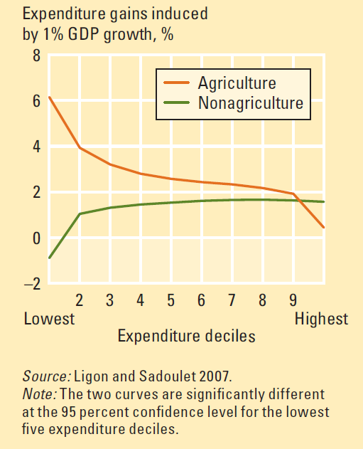
Food security and ways to increase it on a global scale Economic improement of agriculture
Comparison of gains of expenditure induced by a 1% growth of GDP in agriculture or non-agriculture
A large share of the poor live in rural regions
An increase in GDP by agriculture has a larger impact on expenditure of the poorest than if GDP in non-agricultural sectors is increased
Quelle: World Development Report 2008
Notes:
-For example the world bank evaluated in their world development report what the impact of an increase in GDP is on the welfare of people in developing countries
-As an indicator for welfare the used the expenditure of the people. It is assumed that if people can increase their expenditures they are more food secure since they potentially have access to markets. Certainly this is only important for the poor people that would otherwise not have enough money to buy food
-The researcher then figured out what the impact is if GDP is increased in Agriculture and what happens if GDP is increased outside agriculture.
-They could show that if GDP is increased in agriculture mainly the poor can profit. The 10% households with least expenditures can increase their expenditures by 6% induced by this 1% increase in GDP. Only the richest 10% do not increase expenditures if GDP in agriculture is increased, probably since they are less engaged in these value chains
-In contrary if GDP is increased outside agriculture this has a much less positive impact on the expenditures of the poorest, the impact can even be negative perhaps such an improvement goes hand in habd with a substitution of unskilled labor by capital. From an increase of GDP outside agriculture mainly the 80% richest profit.
-This difference may be because farmers also buy their input locally and therefore increase economic turnover. It is however a clear signal that an improvement in food security can best be reached by improving economic situation for agriculture and the food sector

Slide 9
Food security and ways to increase it on a global scale Profitability of different value chains
Profitability of different vegetable value chains in Tanzania
Zoss, 2014
Export value chains show highest profitability
Swiss market difficult to access
Notes:
-The evaluation of possibilities to improve farm income was one of the goals of the PhD thesis of Marc Zoss. For this purpose he analysed different value chains for vegetables in Tanzania.
-With market surveys he gathered the data he needed to compare the different value chains.
-His results showed, that Green markets, i.e. local spot markets, were least profitable for the farmers. In contrary more sophisticated value chains showed a higher profitability. Examples for such more sophisticated value chains were for example processed vegetables, supplying the tourism sector. And the most profitable is the export of fresh vegetables by airplane.
-Even if this data was collected at the level of the marginal return and not the income it is a clear hint, that export of high value crops would have the potential to improve food security since the increased profitability would lead to an increase in the potential expenditures of the poorest.
-Precondition for such a development is however, that their are enough markets that allow imports from these developing countries. Often this is not the case because of tariffs or non-tariff measures for food products in developed countries where the rpfitable markets are

Slide 10
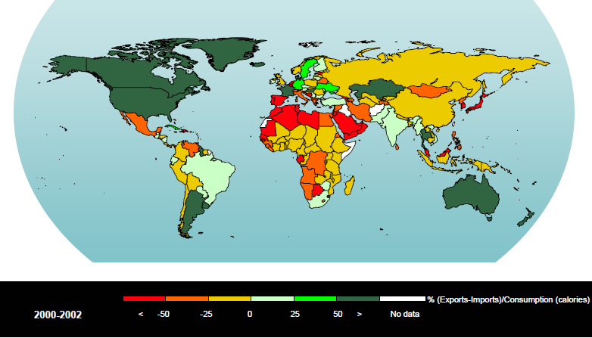
Food security and ways to increase it on a global scale Food security – Access to well working commodity markets needed
-2000-2002
--50
--25
-0
-25
-50
-na
Quelle: FAO 2005
Notes:
-In addition many countries in the regions most affected by climate change are net calory importing countries also today
-If climate change or ressource depletion like the loss of fertile soils is negatively impacting production in these countries they will need even more reliable access to international food markets.
-Under normal conditions this is not a problem. But the food crisis in 2008/2009 has shown that in the case of a crisis most countries again focus on their own consumers, ignoring the negative impacts on other countries. And again suffering are the countries in the south.

Slide 11
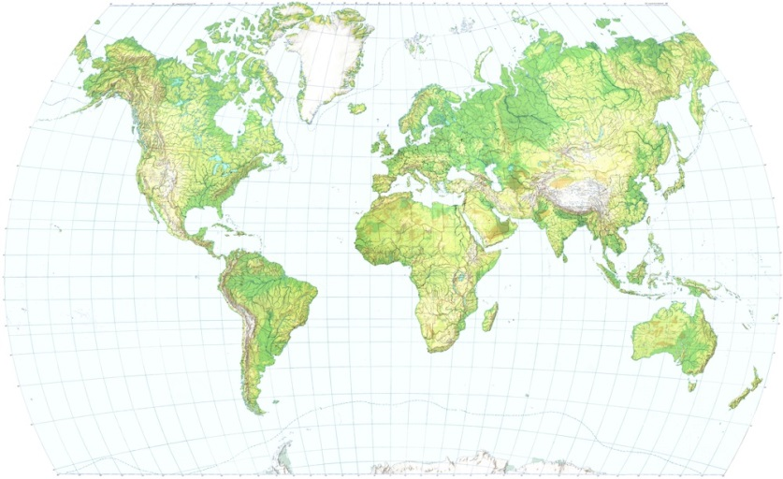
Food security and ways to increase it on a global scale Price volatility induced by exporting countries
In Zukunft:
Lagerbestände abnehmend
Wetter variabler
Konsum steigend
→ Wahrscheinlich-keit von Preispeaks?
Pricepeak in 2008
www.reliefs.ch
Bad harvest in Brazil and Australia
Increasing prices in Ukraine → Export ban
Pressure on prices in Russia→ Export ban
Increasing exports in USA → Decreasing stocks→ Price peak
→ Trade policy of exporting countries had negative impact on global food security
Headey 2011
Notes:
-Such an example was the food crisis in 2008. Headey evaluated the chain reaction that led to the crisis that was a big challenge for the countries in the south.
-The food crisis started with bad harvests in Brazil and Australia. On its own this would not have been a problem. But the threat of increasing prices for food for domestic consumers motivated Ukraine to close its borders for cereal exports. This led the an even shorter supply on international markets.
-This increased shortage motivated russia to close its borders for wheat exports. The only remaining large exporter of cereals was North America that had to supply the whole world. This led to decreasing stocks and subsequently to rocketing prices.
-Certainly also if countries would not have banned exports prices for agricultural products would have been raising but certainly not in the same scale since the volume on the market still would have been much larger
-In this case again the developped world would have a responsability also for the other – less powerful – countries

Slide 12
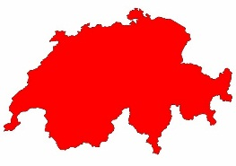
The Swiss Food System in a global context CH Food-trade – in relation
The world produces food to nourish CH from 1st January to end of May
Value of imported food products is the GDP of Mozambique
CH produces as much cereals as Angola or Haiti import
Switzerland produces the world’s breakfast for the 1st January
→ Switzerland has an impact on the markets
Notes:
-We could now argue that these problems must be addressed by larger countries and that Switzerland because of its small size does not have an impact on global markets and therefore no responsability
-We must however take into account, that Switzerland produces as much cereals as Haiti imports in a year. And if we compare the purchasing power it is clear who would get this food on the markets
-Even more important is, that Switzerland currently buys foodstuff in the value of 15 billion CHF from other countries. Certainly a share of this food are processed products not raw materials. But nevertheless the value of the imports equals the GDP of Mozambique. And this in the current situation with a very restrictive boarder protection with high tariffs and so on…
-This means also Switzerland has a responsibility for global food security – on the production as well as on the side of imported products.
-Why Swiss agricultural policy has difficulties in dealing with this problems as well as what could be a way out is explained on the following slides.

Slide 13
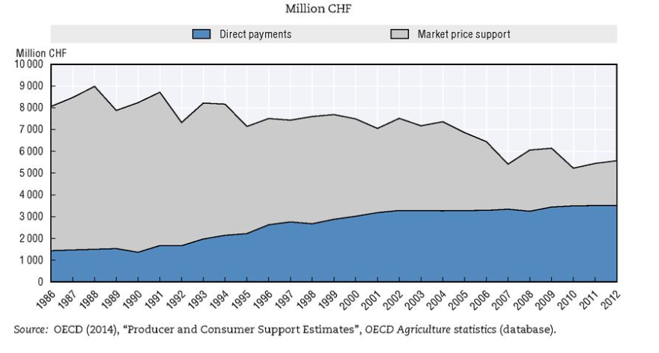
What are the obstacles Competitiveness of Agriculture
→ Turnover of each farm is increased by 40’000 CHF/year
Source: OECD 2015
Notes:
-The major problem is the past, when agriculture was mainly supported by tariffs on agricultural products. Certainly this support was reduced substantially during the last two decades but the support is still considerable with 40’ CHF per farm and year.
-This has led to a production structure that is not competitive in an international comparison. Our farms produce other products as they would with open borders. Perhaps they would also be larger if we would have a lower support or they would rely more on off-farm incomes like farms in Austria.
-I’m convinced that our farmers would have the potential to adapt their production structure in case of a lower support.
-But farmers are not the only ones who would have to adapt…

Slide 14
What are the obstacles
High costs for production factors
Prices for factors of production
→ Industry delivering inputs for agriculture profits from producer support…
Source: BAK 2014
Notes:
-Since the farmers get higher prices for their products compared to the neighbouring countries they are also willing to pay higher prices for their production factors. This fact is used by industry supplying agriculture to improve their profitability
-Certainly a share of these higher costs are also caused by the higher cost in the «high price island» Switzerland. But the willingness to pay of the farmers certainly is a more important factor.

Slide 15
What are the obstacles Way out: Abolishing tariffs together with gradually reduced compensation
Aggregated compensatory payments
t0 = CHF 2 Bio./Year (estimated)
m = - 100-120 Mio. CHF/Year
P
Compensatory Payments
Pdom
CH-Bonus
PWorld
t0
t20
t
Notes:
-A possible way out to this dilemma could be a solution where tariffs are abolished for the whole food sector in one step. Favourably this step would be made as part of a free trade agreement with a large market player like the European union. Such a free trade agreement would provide the Swiss agriculture and food industry access to a large market with many consumers
-Such abolishment of tariffs would have to be accompanied by compensatory payments. This is necessary since the structures in Swiss Agriculture were grown during a long time. A change of the structure and an adaptation to the new possibilities would therefore take some time
-To motivate farmers to really make the adaptations the payments must be reduced gradually to 0 during a certain time span e.g. 20 years.
-If we start with a full compensation of 2 bio CHF a reduction of 100 Mio CHF per year would be necessary

Slide 16
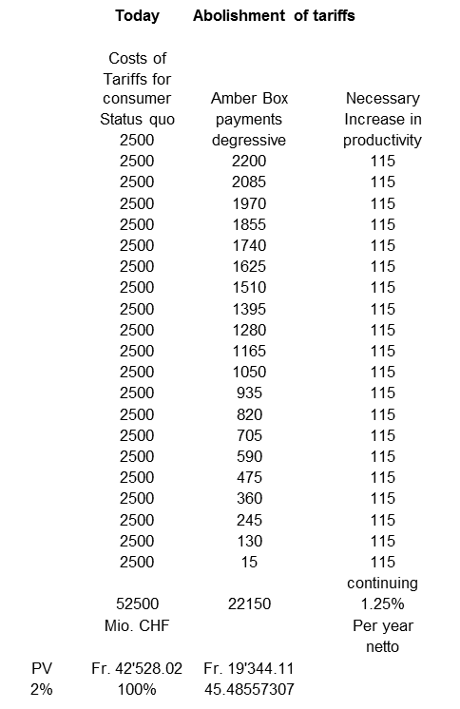
What are the obstacles Solution with various advantages
Agriculture and food industry would have the possibility to move into new markets
Actors would have time to adapt – potentially less opposition against change
The sector would have clear perspectives
In the long run this solution would be cheaper for consumer and taxpayer
Focus on products with comparative advantage would allow Switzerland to improve global food security…

Slide 17
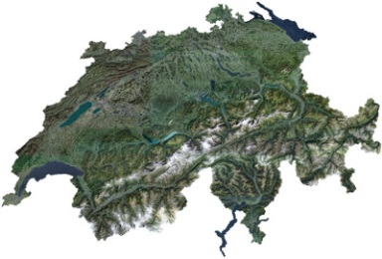
…and allow the implementation of a sustainable Swiss food system
Long-term food security in Switzerland
a) Protecting resources for production, mainly fertile soils
b) Efficient use of our resources in line with local capacity
c) Competitive agriculture and food industry
d) Access to international food markets
e) Resource efficient consumption

Slide 18
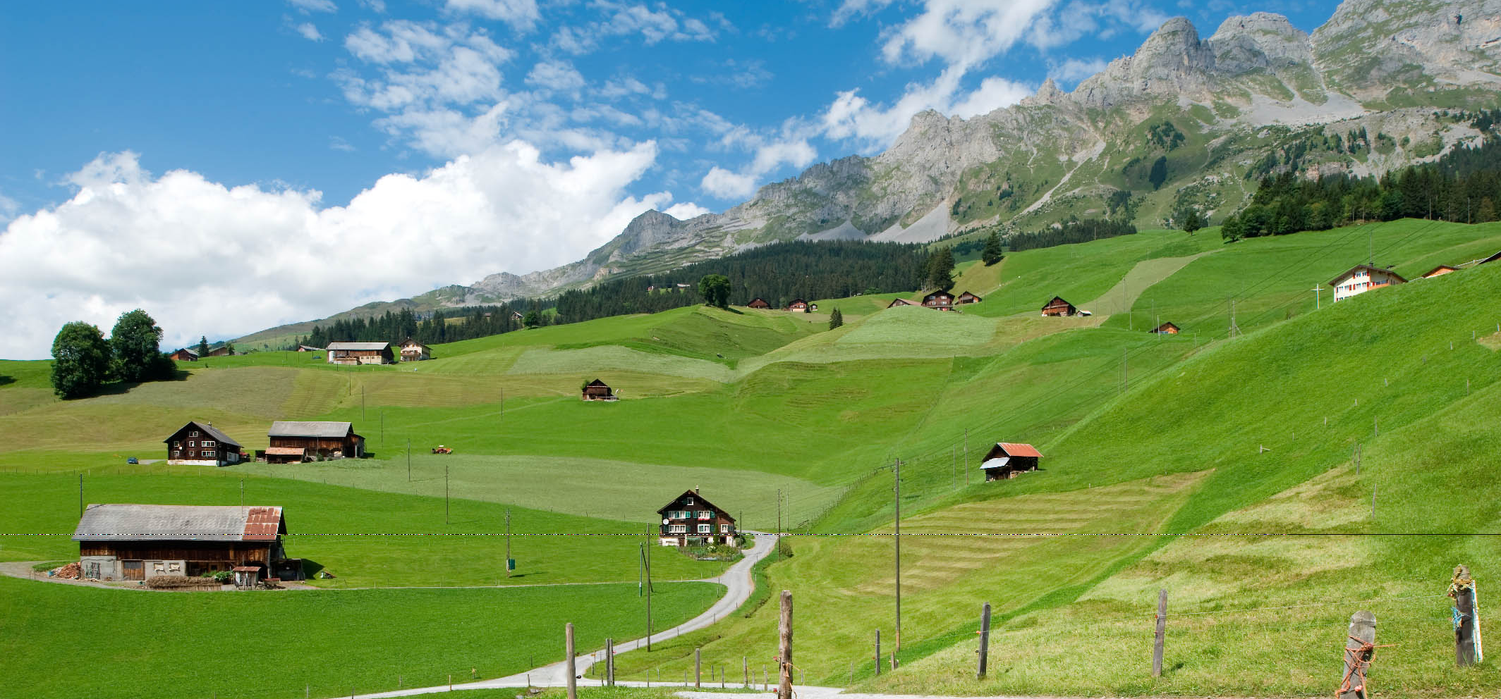
Thank you for your attention!
Schweiz. Natürlich.

Slide 19
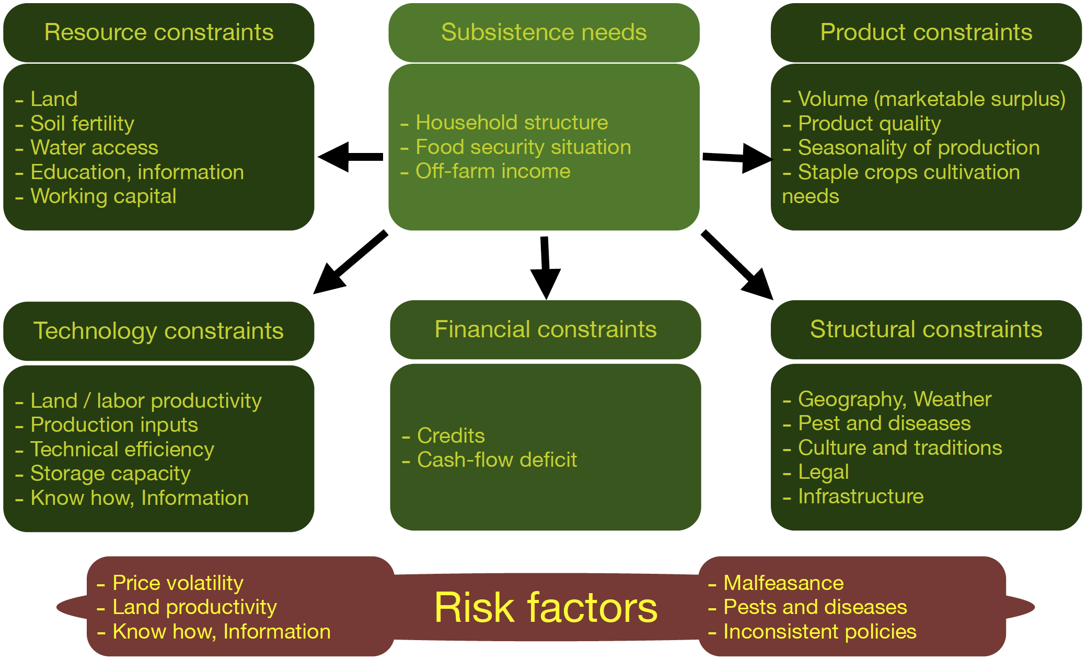
Constraints and risks linked to market integration of small scale farms
Quelle: Arias, P. et al. (2013): Smallholder integration in changing food markets, FAO

Slide 20
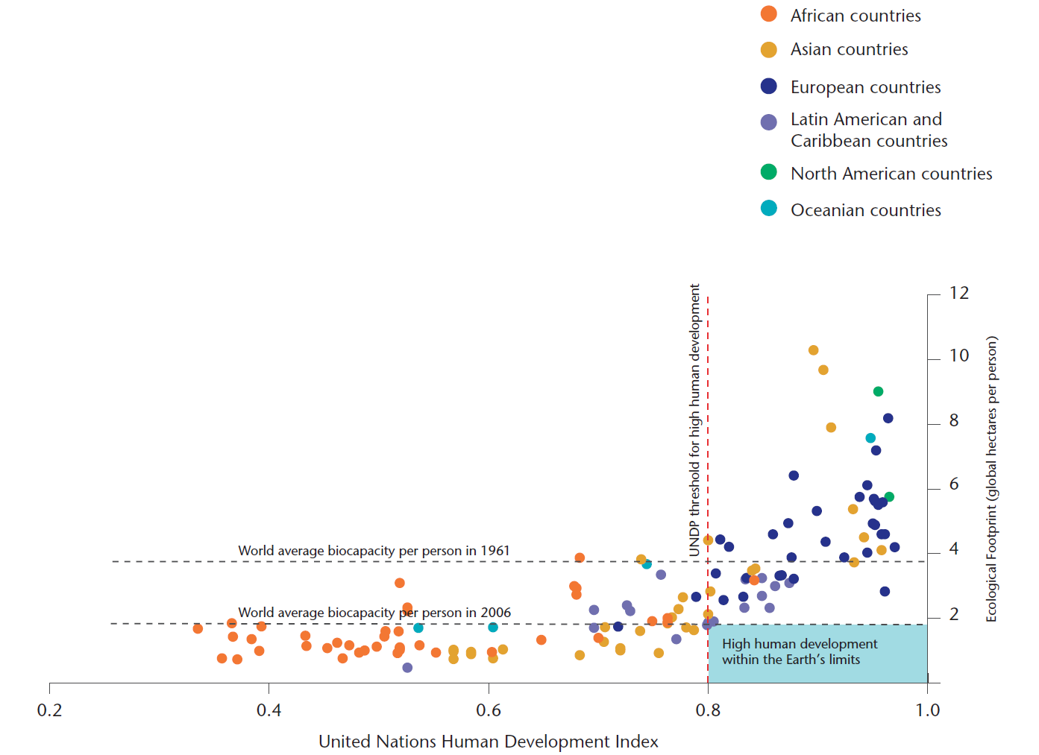
Huge challenges for the global food system
Quelle: Global Footprint Network (2009). Data from Global Footprint Network National Footprint Accounts, 2009 Edition; UNDP Human Development Report, 2009 in: World Business Council for Sustainable development: Vision 2050 (http://www.wbcsd.org/pages/edocument/edocumentdetails.aspx?id=219&nosearchcontextkey=true
Notes:
We need to fight hunger and food insecurity,
fight poverty, improve livelihoods and
safeguard natural resources and ecosystems globally

Slide 21
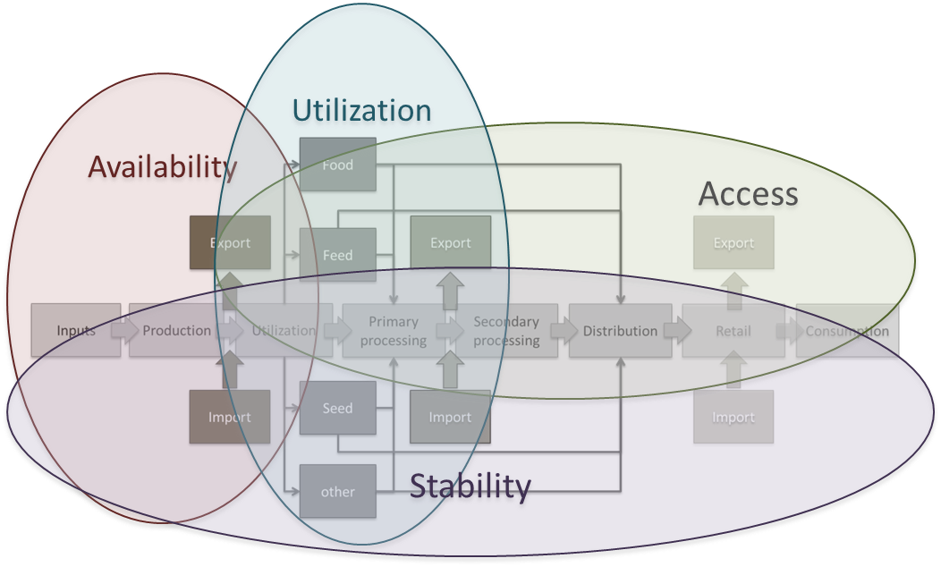
Food security and ways to increase it on a global scale Concept
Source: Sonnevelt 2011

Slide 22
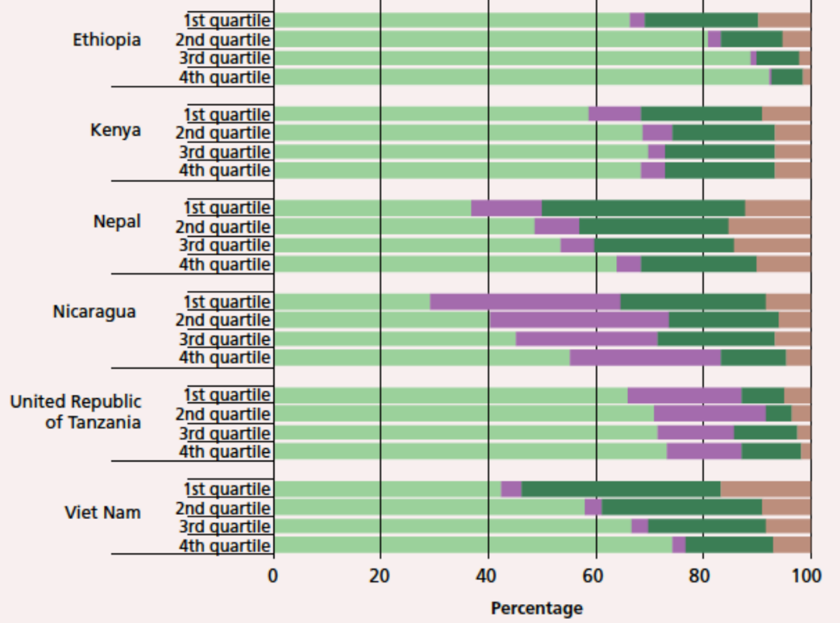
Food security and ways to increase it on a global scale Farm households have many income sources but farming is dominant
Quelle: FAO 2014: SOFA 2014
Notes:
-In most countri

