Slide 1
The Geoeconomics of the Twenty-First Century
Michael Lind
Visiting Professor
The Lyndon B. Johnson School of Public Affairs
The University of Texas

Slide 2
Population Growth to 2050: The Rise of Africa and India
Source: “Population Growth 2000-2050,” Institut National D’Etudes Demographiques (INED)

Slide 3
Global Population in 2100
Source: Metrocosm, How to Make Cartograms With Animation
October 11, 2015

Slide 4
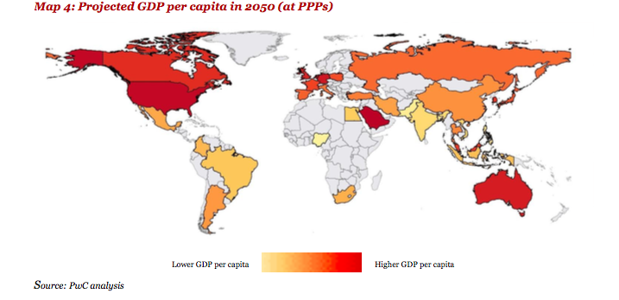
Relative Income Levels in 2050
Source: “The Long View: How will the global economic order change by 2050?” (February 2017), Pwc.com

Slide 5
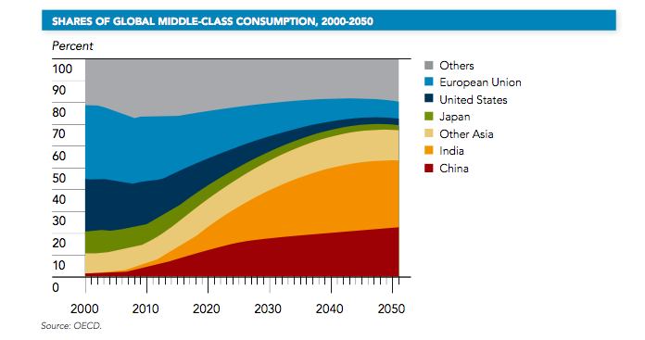
Shares of Global Middle-Class Consumption, 2000-2050
Source:
National Intelligence Council, “Global Trends 2030: Alternative Worlds” (December 2012), NIC 2012-001, p. 9.

Slide 6
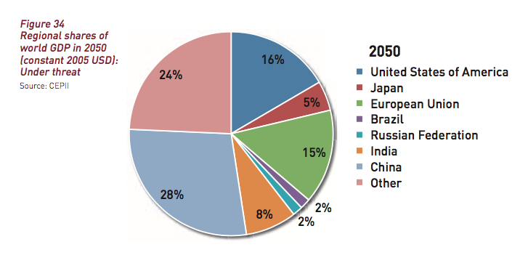
Shares of global GDP in 2050: One Estimate
SOURCE: The European Commission: Directorate-General for Research and Innovation Socio-economic Sciences and Humanities, “Global Europe 2050” (2012), p. 82, Figure 34, “Regional shares of world GDP in 2050 (constant 2005 USD): Under threat Source: CEPII.”

Slide 7
The Relative Decline of the West and the Rise of Asia
Source: “China to dominate global economy by 2050, US to fall behind India, Russia to top Europe – PwC,” RT 7 February 2017

Slide 8
Sino-American Trade Rivalry in Asia: The RCEP vs. the TPP
Source: Oxford Analytica

Slide 9
All Roads Lead to China: One Belt, One Road (OBOR)
Source: Karen Gilchrist, “China’s ‘Belt and Road’ initiative could be the next risk to the global financial system,” CNBC, August 2017.

Slide 10
An Economic NATO: The Failed Transatlantic Trade and Investment Partnership
Map from Wikipedia

