Slide 1


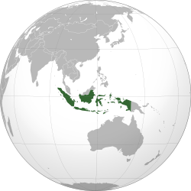
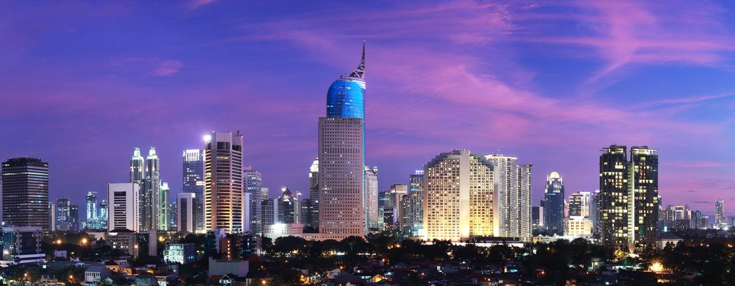
Prof. Muliaman D. Hadad, Ph.D
Ambassador of the Embassy of The Republic of Indonesia to Switzerland and Liechtenstein
Global Financial Reform and Crisis
Management Protocols:
Indonesia’s Experience
World Trade Institute, Bern, 22 October 2018

Slide 2




Global Financial Reform and Crisis
Management Protocols:
Indonesia’s Experience
OUTLINE
Global Financial Reforms
Challenges & Recommendation
What Indonesia has done
Current Economic & Financial Sector Condition

Slide 3
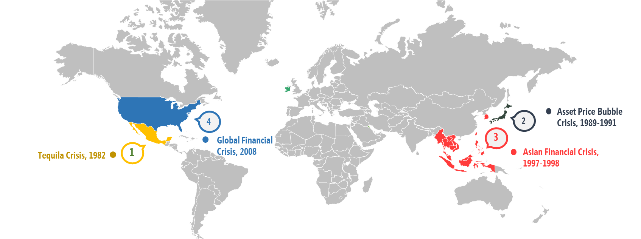
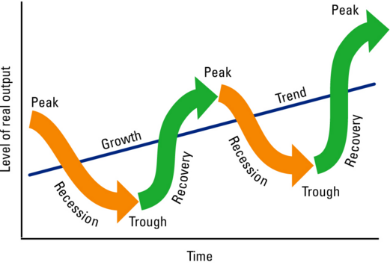

I. Global Financial Reforms
STABILITY FOR A SUSTAINABLE GROWTH
Lessons learned from two big crisis: the importance of safeguarding financial system stability
Stability becomes a “mantra” for creating a robust and sustainable economic growth
A resilient financial system is a must in confronting possible shocks in the economy and financial markets.

Slide 4
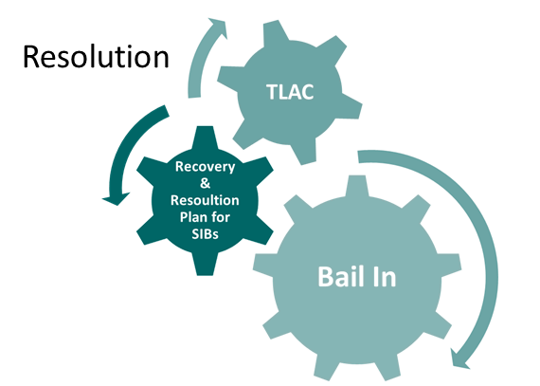
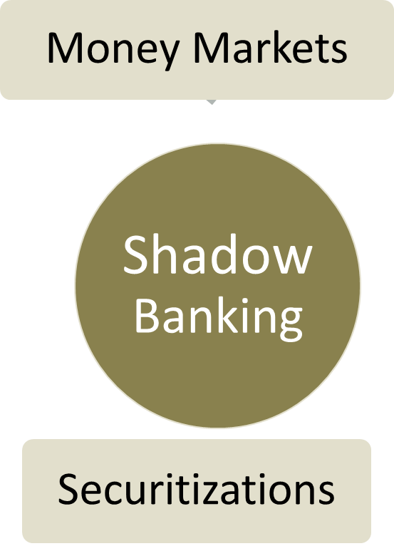
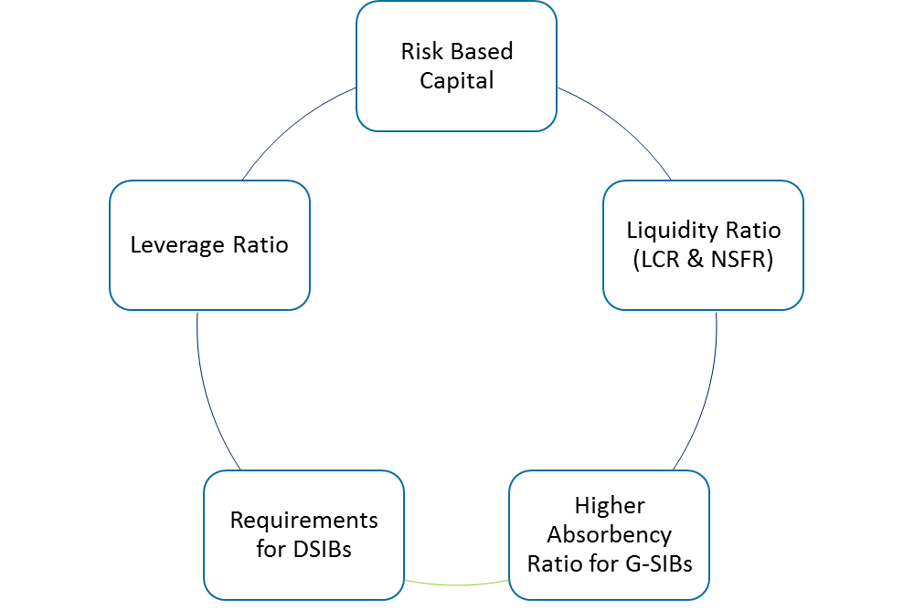
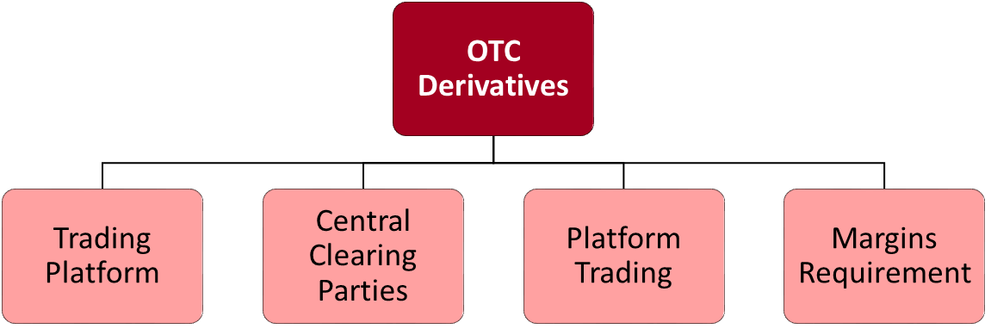
I. Global Financial Reforms
In the Aftermath of The Global Financial Crisis, The G-20, through the FSB, launched a comprehensive programs of reforms to increase the resilience of the Global Financial System while at the same time preserving the open and integrated market structure.
Building Resilient Financial Institutions
Ending to Big To Fail
Making Market Derivatives Safer
Transforming Shadow Banking
Risk Based Capital
Liquidity Ratio (LCR & NSFR)
Higher Absorbency Ratio for G-SIBs
Requirements for DSIBs
Leverage Ratio
Compensation
Basel III
Microprudential
Macroprudential
Increasing The Resilience of The Global Financial System
Source : IMF, FSB

Slide 5


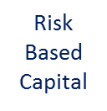
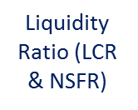
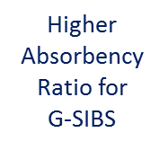



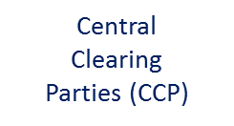


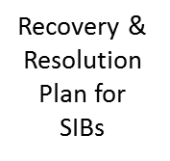





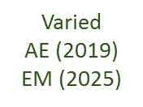
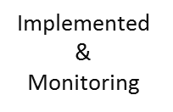
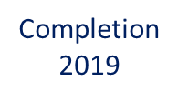




I. Global Financial Reforms: Timeline
Building Resilient Financial Institutions
Ending to Big To Fail
Making Market Derivatives Safer
Transforming Shadow Banking
Basel III
OTC Derivatives
Resolutions

Slide 6
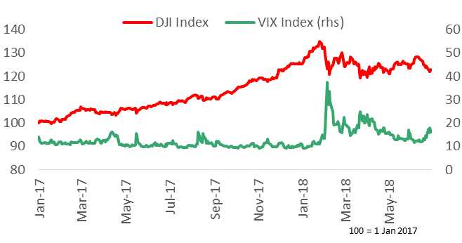
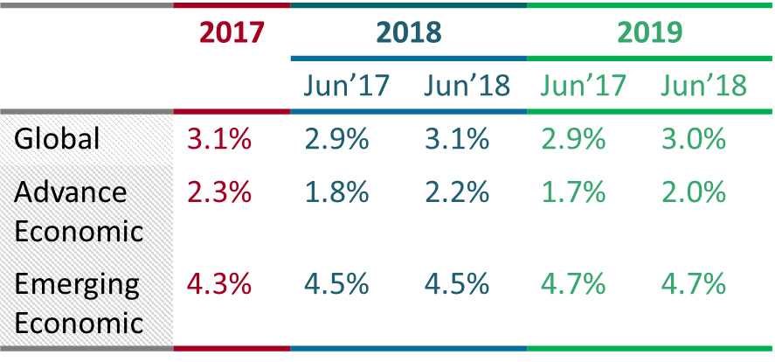
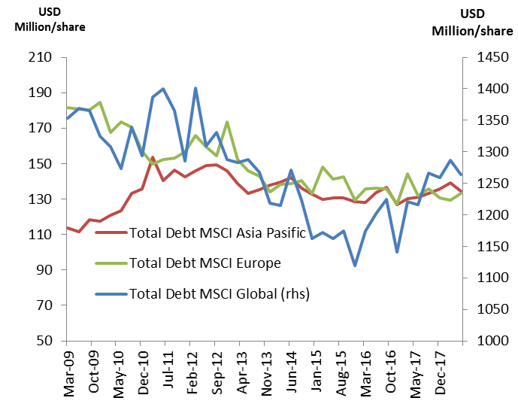
Global Financial Reforms: Effectiveness
In general, the reforms has increase the resilience of the financial System, particularly the Banking System. However some issues still persist.
 | 2017 | 2018 |  | 2019
 |  | Jun’17 | Jun’18 | Jun’17 | Jun’18
Global | 3.1% | 2.9% | 3.1% | 2.9% | 3.0%
Advance Economic | 2.3% | 1.8% | 2.2% | 1.7% | 2.0%
Emerging Economic | 4.3% | 4.5% | 4.5% | 4.7% | 4.7%
Global Economic Growth has been positive
…and volatility persist
Mix
Result
Source: Global Economic Prospect, World Bank, Juni 2018
Source: Bloomberg
But leverage still high…
…and corporate debt remains high
Source: BIS
Source: Bloomberg

Slide 7

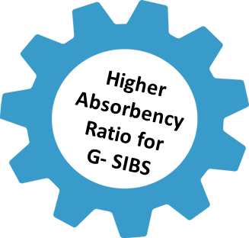
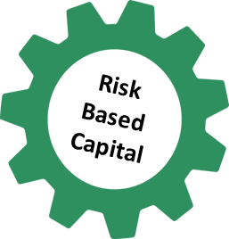



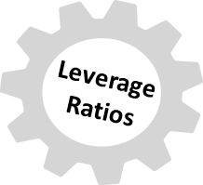




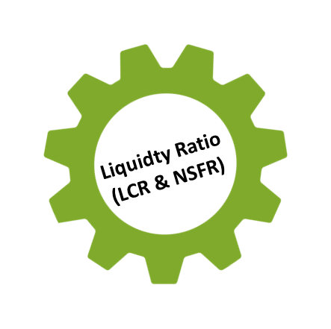
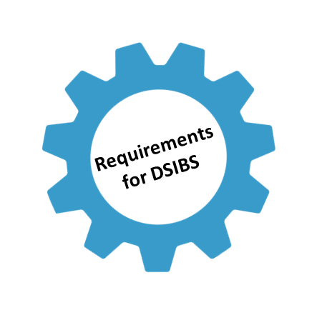
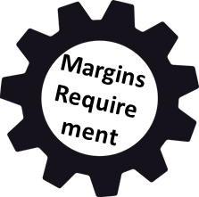

II. Challenges & Recommendation
Why? Some Contributing Factors...
Stability vs Growth Issues. This is particularly relevant for Emerging Economies that still rely on a Bank Based Lead Economy.
High Cost of Reform and Resource Limitation
Structure of the Banking System “adapts” as the reform is being implemented.
For example; instead of deleveraging banks de-risk their asset structure in order to comply with the capital requirements.
Too Many Initiatives, Inconsistencies, Double Penalized, Complex
Movement of activities towards non-bank sector and shadow banking
The growth of the FinTech Sector present new sets of challenges.

Slide 8
II. Challenges & Recommendation
Middle Path, Balancing Growth and Stability
A holistic impact analysis should be conducted
Simplify
The complexities involved, hinder the effectiveness of the reforms.
Recommendation
Enhancing Supervision not just regulation
The primary focus of the reforms has been on regulation. But the supervisory tools and framework have yet to be address fully

Slide 9
III. What Indonesia has done
2013
2014
2015
2016
2017
2018
2019
Issue of Regulation on CAR (Basel III)
Tier 1 minimum 6%
CET 1 minimum 4,5%
Capital requirements according to PBI become effective as 1 January 2015
0,625% 1,25% 1,875% 2,5%
Countercyclical Buffer (0- 2,5%)*
Capital Surcharge D-SIB (1-2,5%)
*Based on macro economic study, Countercyclical Buffer can be implemented earlier than 2016

Slide 10
III. What Indonesia has done
Basel III Implementation in Indonesia
Regulation | Status | Target Threshold | Fullfillment | Current Threshold | Notes
Countercyclical Capital Buffer | Regulation issued | Ranging from 0% - 2.5% | In full | 0% | Regulation issued in 2016 Threshold reviewed and set every 6 months
Net Stable Funding Ratio (NSFR) | Regulation issued | 100% | In full | 100% | Regulation issued in July 2017 Regulation in force since January 2018
Liquidity Coverage Ratio (LCR) | Regulation issued | 100% | Gradually | 90% | Regulation issued in 2015 Threshold to be applied fully in Dec 2018
D-SIBs capital surcharge | Regulation issued | 1% to 2.5% | Gradually | 0.25% to 0.625% | Regulation issued in 2015 Threshold to be applied fully in Jan 2019 Threshold varies between bucket categories
Conservation Buffer | Regulation issued | 2.5% | Gradually | 1.875% | Regulation issued in 2016 Threshold gradually increasing annually Threshold to be applied fully in Jan 2019
Leverage Ratio | CP published | 3% | In full | 3% | CP based on 2014 BCBS’ Leverage Ratio Standard published in 2014 Regulation to be issued in 2019 integrating BCBS’ 2017 amendments

Slide 11
III. What Indonesia has done
Basel III Implementation in Indonesia
Regulation | Status | Notes
Credit Valuation Adjustment (CVA) | Regulation issued | Regulation issued in 2016 (for 2011 standard)
Standardised Approach for Counterparty Credit Risk (SA-CCR) | Regulation issued | Regulation issued in September 2017 Regulation in force as of January 2018
Interest Risk Rate in The Banking Book (IRRBB) | CP published | CP published in June 2017 To be issued in Q3 2018 Banks to first report based on June 2019 data
Large Exposures (LEX) | CP published | CP published in September 2017 To be issued in Q4 2018
Finalising Post Crisis Reforms
Regulation | Status | Implementation Target | Notes
Revised operational risk framework | CP published | 2022 | CP published in June 2018
Revisions to standardized approach for credit risk | Under study | 2022 | CP to be published in Q4 2018
Revised CVA framework | Under study | 2022 | -
Leverage ratio | Under study | 2019 | -

Slide 12













III. What Indonesia has done
INDONESIA’S FINANCIAL SYSTEM SAFETY NETS
A new Law on the Prevention & Resolution of Financial System Crisis was enacted in 2016, providing a legal basis for relevant authorities to maintain national financial system stability.
Scope of the Law
Prevention (surveillance & maintenance of financial system stability)
Resolution of financial system crisis
Resolution of problem systemic banks
Main Principles of the Law
Strengthening coordination of 4 institutions
More thorough resolution methods
Enhancing banking supervision
President’s control
Bail-in

Slide 13

III. What Indonesia has done: Bail - In
Crisis Prevention
Crisis Resolution
Strengthening Individual Bank
Implementation of Basel III and IFRS 9
Banks Establish Bail – In Instrument
[2021]
Submission of Recovery Plan by Banks
[2020]
Implementation of Financial Safety Net Law
Recovery Plan (RP) Regulation
Bridge Bank Policy
[2019]
Establishment of Bank Restructuring Fund (Planned)
[2018]
The Fin.Safety Net Law introduced the “no bail-out” paradigm for resolution regime in Indonesia
2 approaches are used; (i) establish bail-in instruments by banks, and (ii) establish a bank restructuring fund
[2017]
[2016]
Will It Suffice?
Given the magnitude of banking crisis and how securities behave in market turmoil, can the no-bail out principles hold?
Enactment of Fin. Safety Net Law

Slide 14


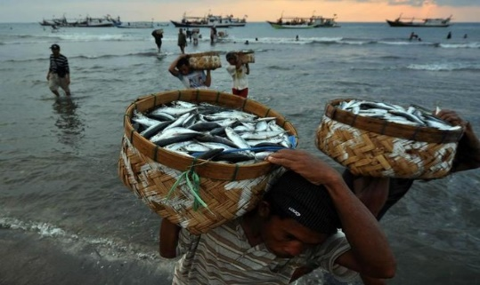



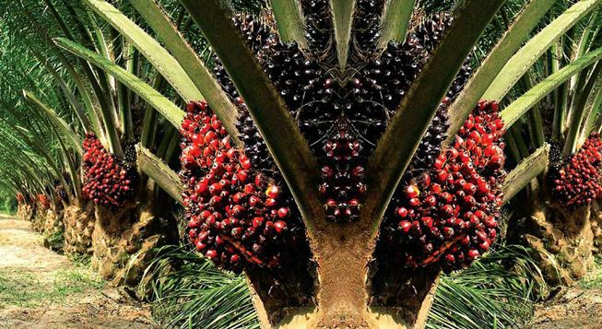



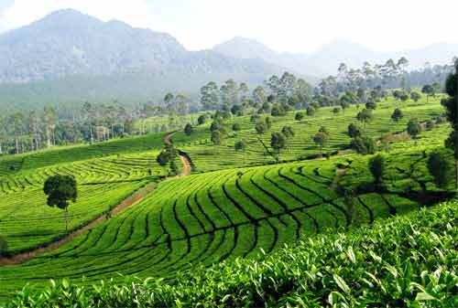

14
IV. Current Economic & Financial Sector Condition
Indonesia Stylized Facts
The world’s largest archipelagic nation, consists of over 17,500 islands stretching 3,261 miles from east to west wider than distance from Washington DC to San Fransisco California;
Home to abundant natural resources and variety of commodities;
The world’s fourth most populous country, with 64% classified as productive age;
A G-20 country with GDP over USD1 tn & the 3rd highest G20’ economic growth (average in 10 years);
Enjoying the demographic bonus in 2020-2035;
Growing middle income class that is projected to double by 2020;
Establishing of downstream processing industries and massive infrastructure development in all regions;
Increasing technology-savvy population
Notes:
I would like to give a snapshot and short tour on the wonderful Indonesia.
Indonesia is an archipelagic island of over 17,500 islands located at the equator and stretched for more than 3,000 miles from east to west.
Indonesia is home to abundant natural resources, commodities, variety of cultures, and diversified biota.
In terms of the economy, the size of Indonesia GDP is over USD1 trillion and currently positioned itself among G-20 countries. We do enjoy stable economic growth that in the past 10 years or so is ranked the 3rd highest in the G20.
Indonesia is currently enjoying the demographic bonus era. The country’s economic growth over the past decade has resulted in an influx of Indonesians into the middle-class category, providing opportunities for an economic boost. We are expecting our middle income class to double in 2020.
Current administration is also determined to push toward massive infrastructure development to support regional economic growth and to alleviate poverty as well as income inequality.
Going forward our focus will shift more to human development from current priority of infrastructure development.

Slide 15
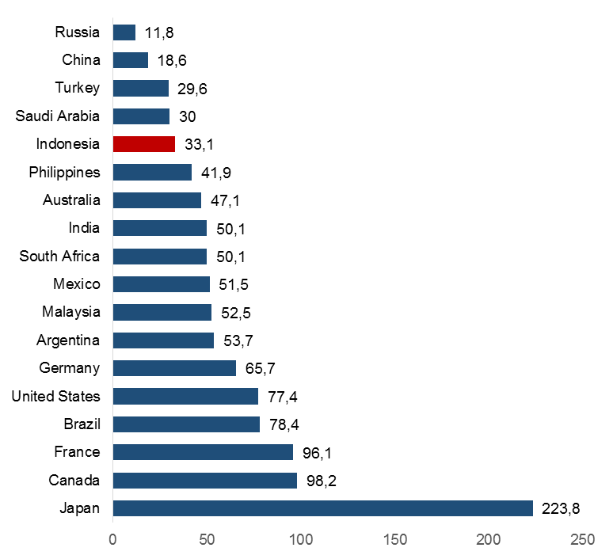
IV. Current Economic & Financial Sector Condition
Indonesia has maintained its stable GDP growth,
compared to peers
Debt ratio remains low in comparison to other G-20 countries
Public debt to GDP (%)

Slide 16
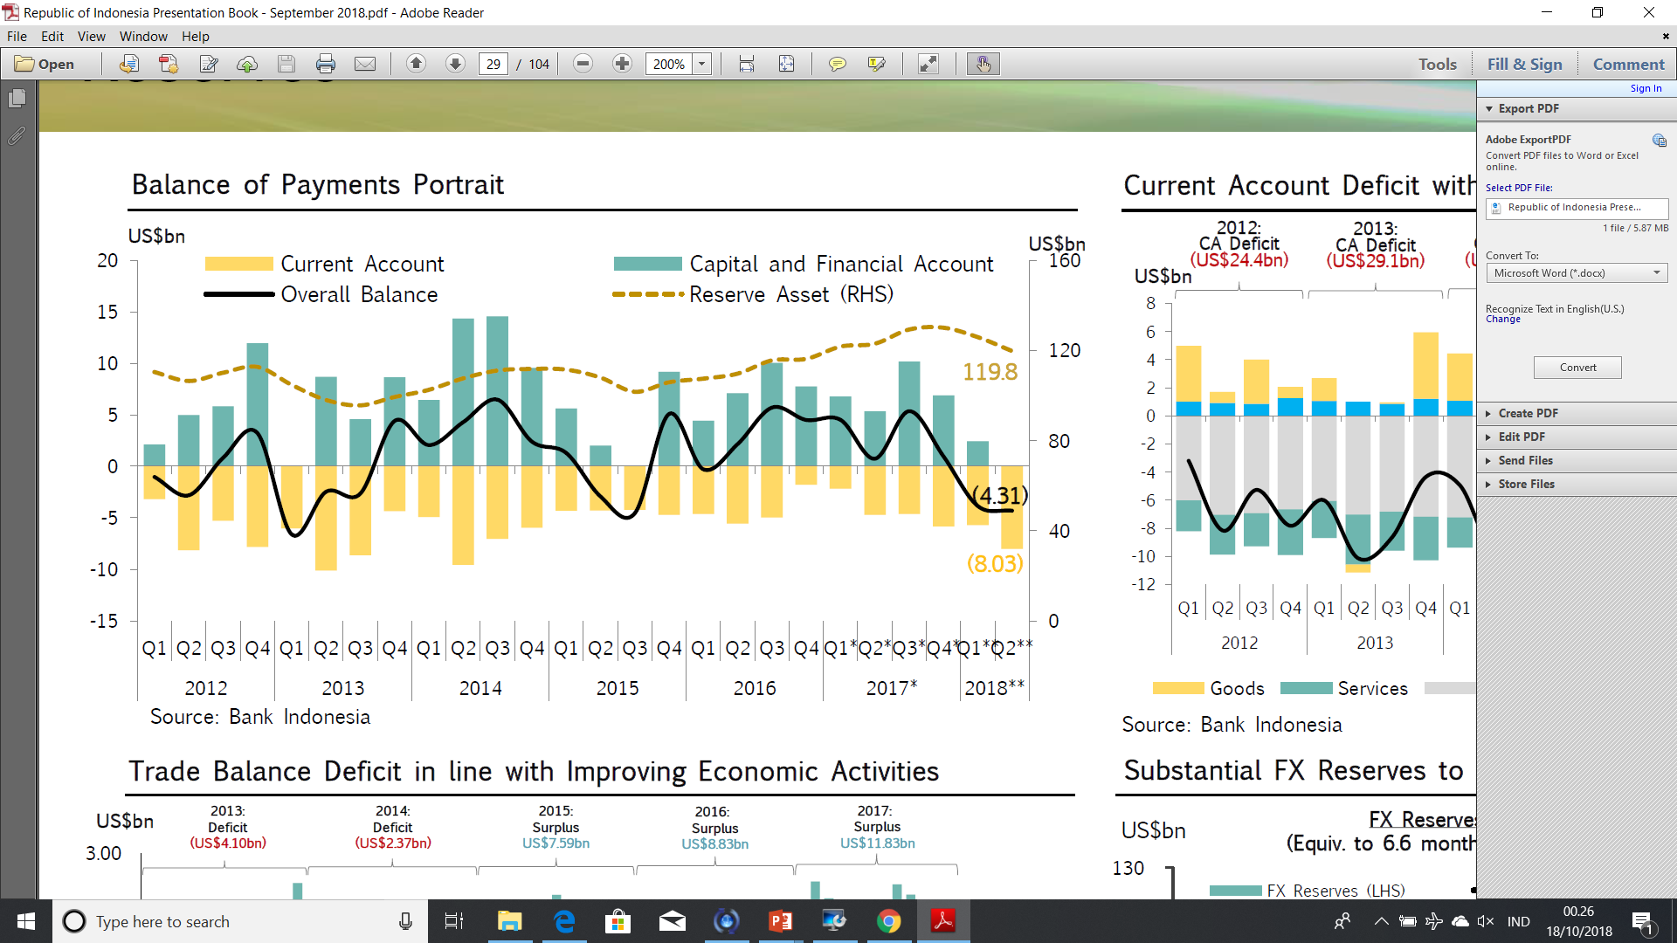
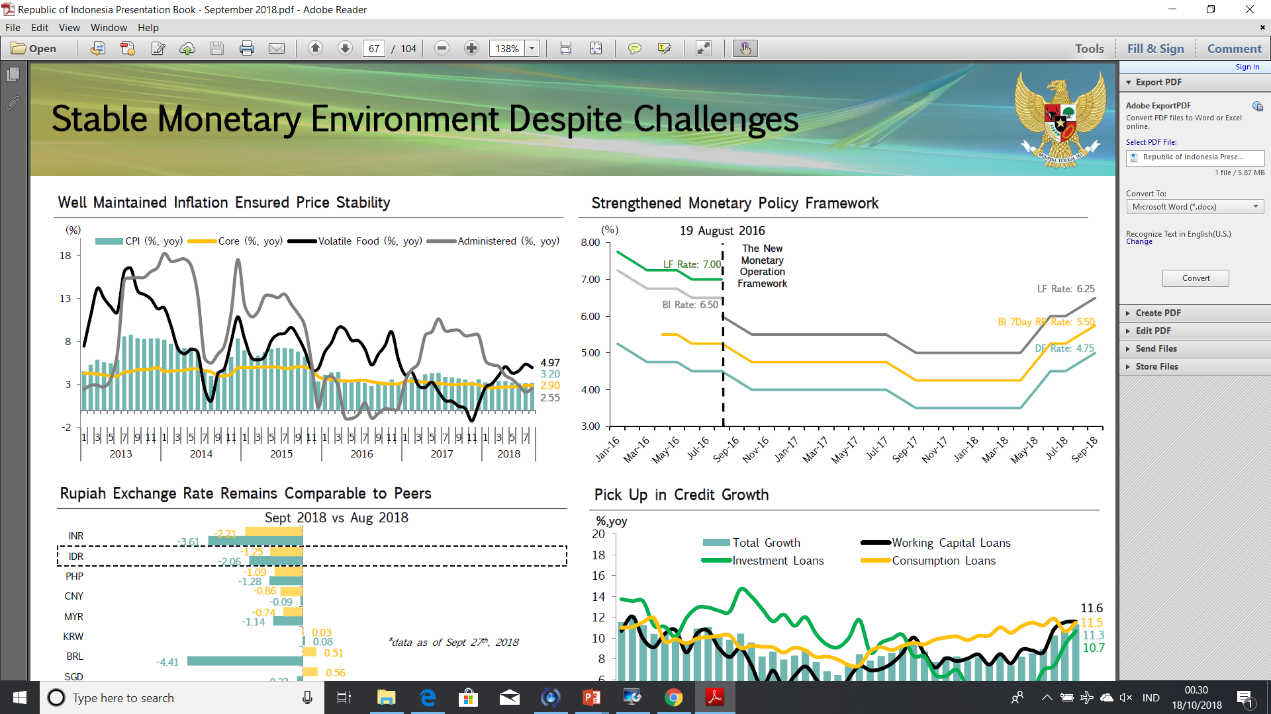
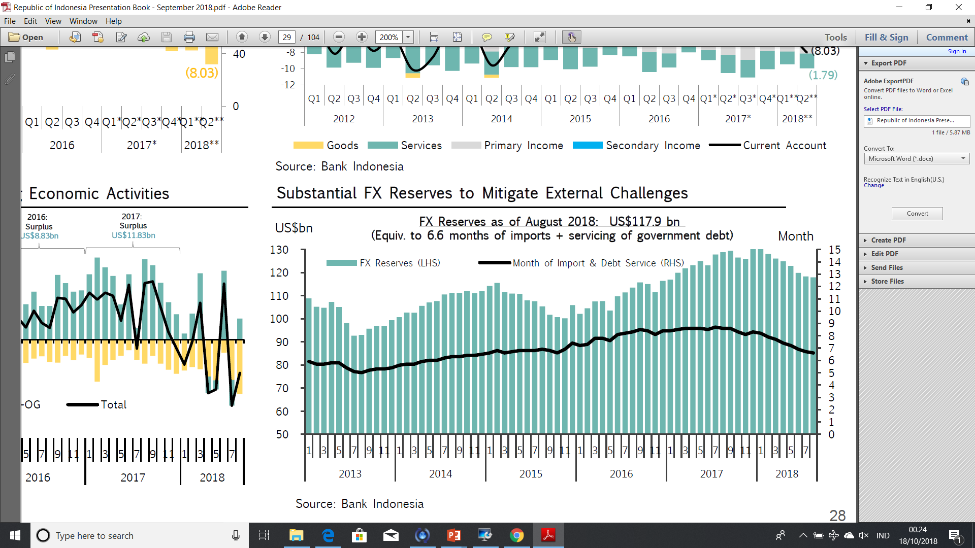
IV. Current Economic & Financial Sector Condition
Balance of Payments
Adequate FX Reserve to mitigate external challenges
Well maintaned inflation ensured price stability

Slide 17

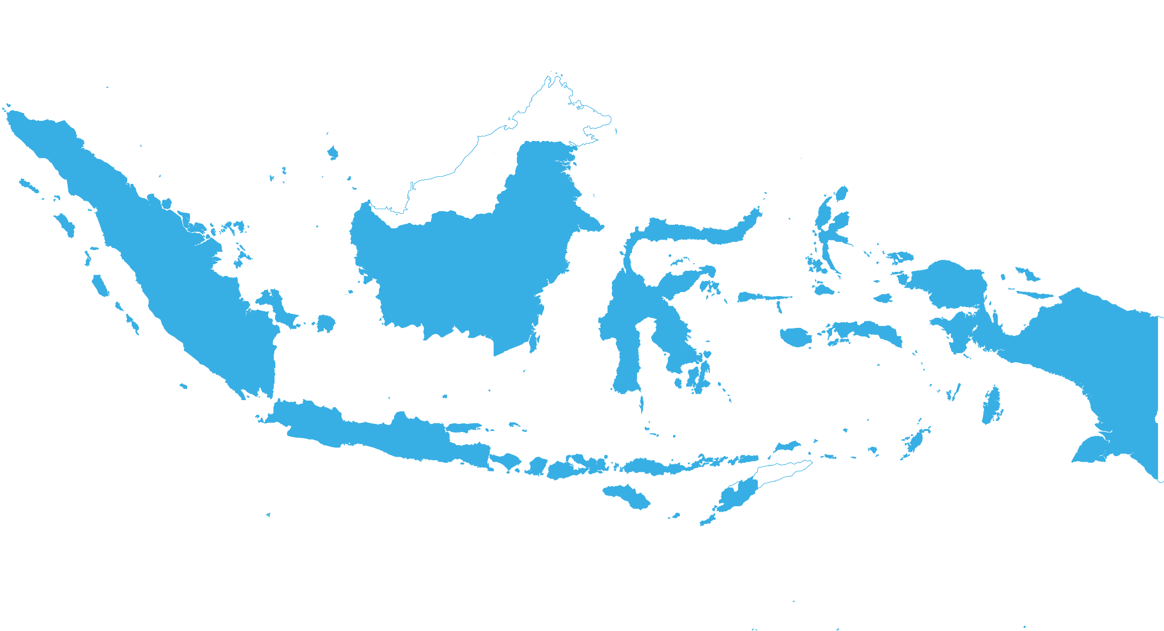
TERIMA KASIH

