Slide 1
WTO Ministerial Conferences

Slide 2
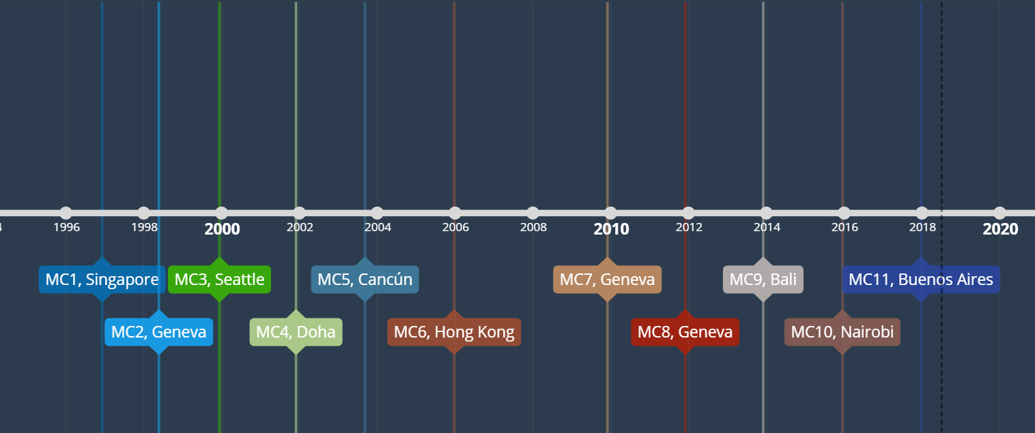
Timeline

Slide 3
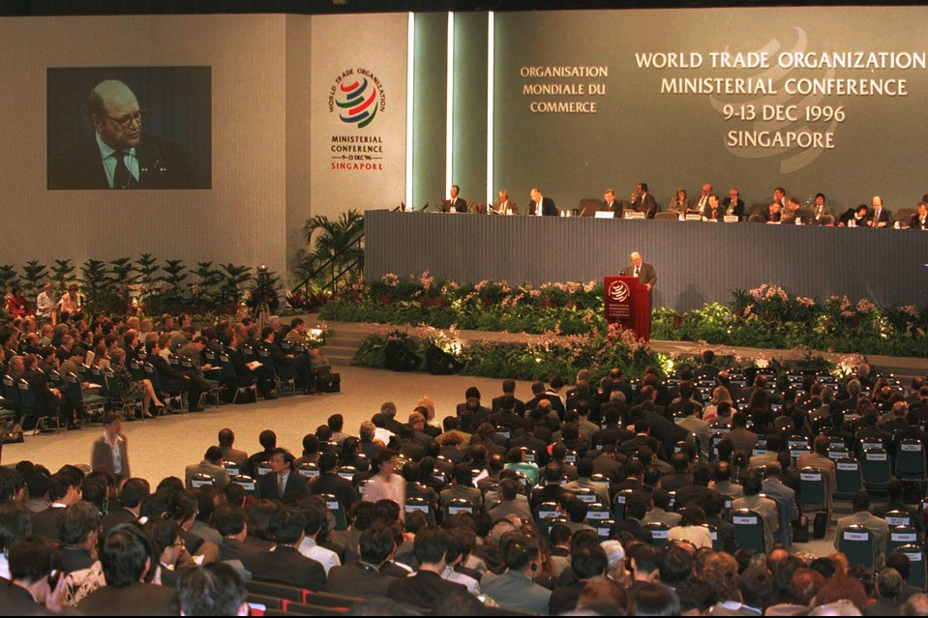
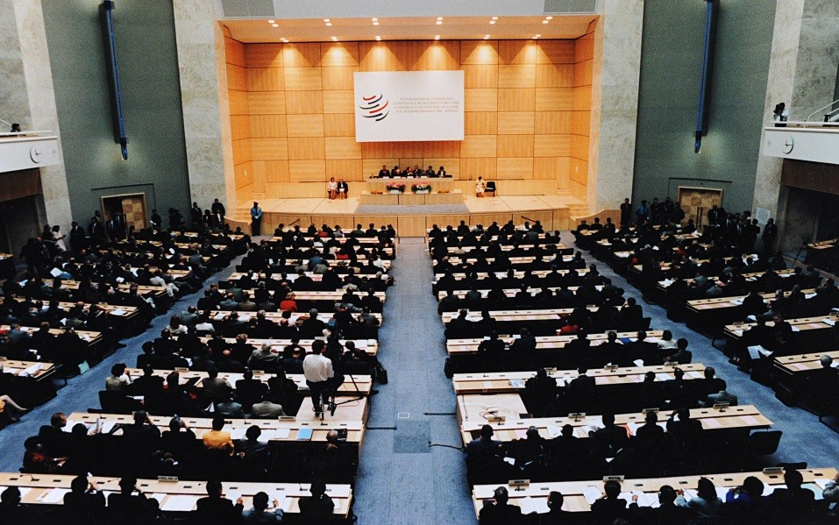
MC2 - May 1998, Geneva
MC1 and MC2
MC1 - December 1996, Singapore

Slide 4
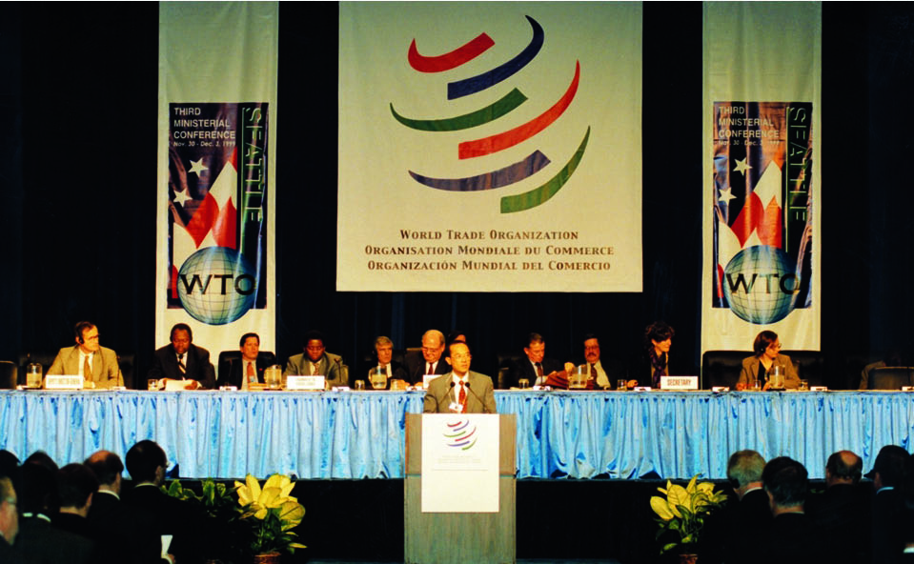
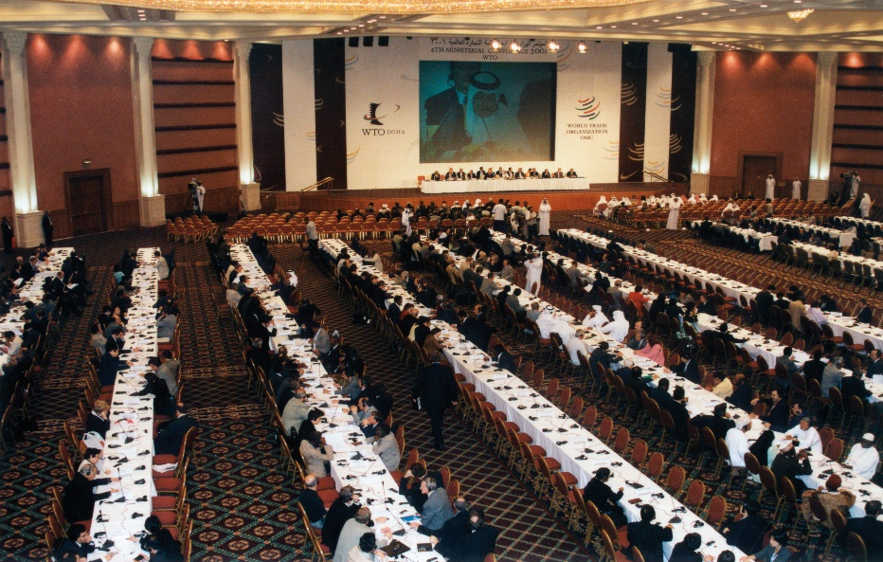
MC4 – November 2001, Doha
MC3 and MC4
MC3 – December 1999, Seattle

Slide 5
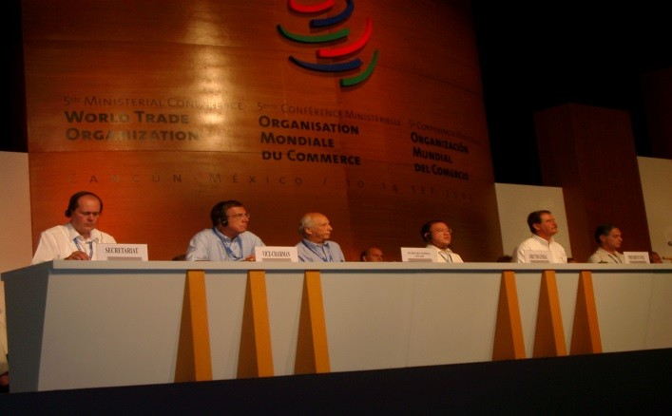
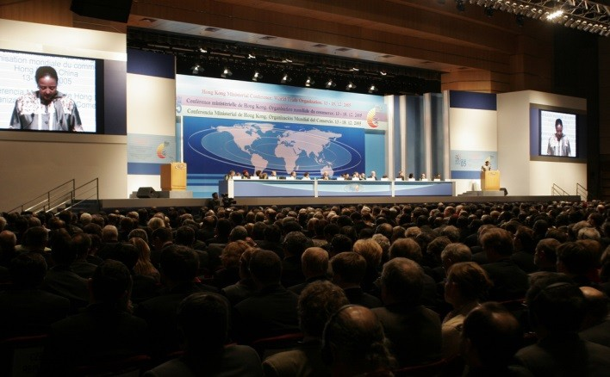
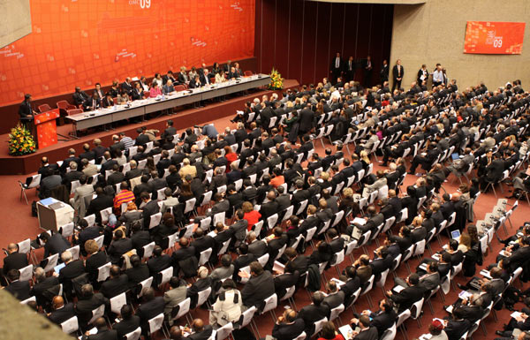
MC5, MC6, MC7
MC5 – September 2003, Cancún
MC6 – December 2005, Hong Kong
MC7 – December 2009, Geneva

Slide 6
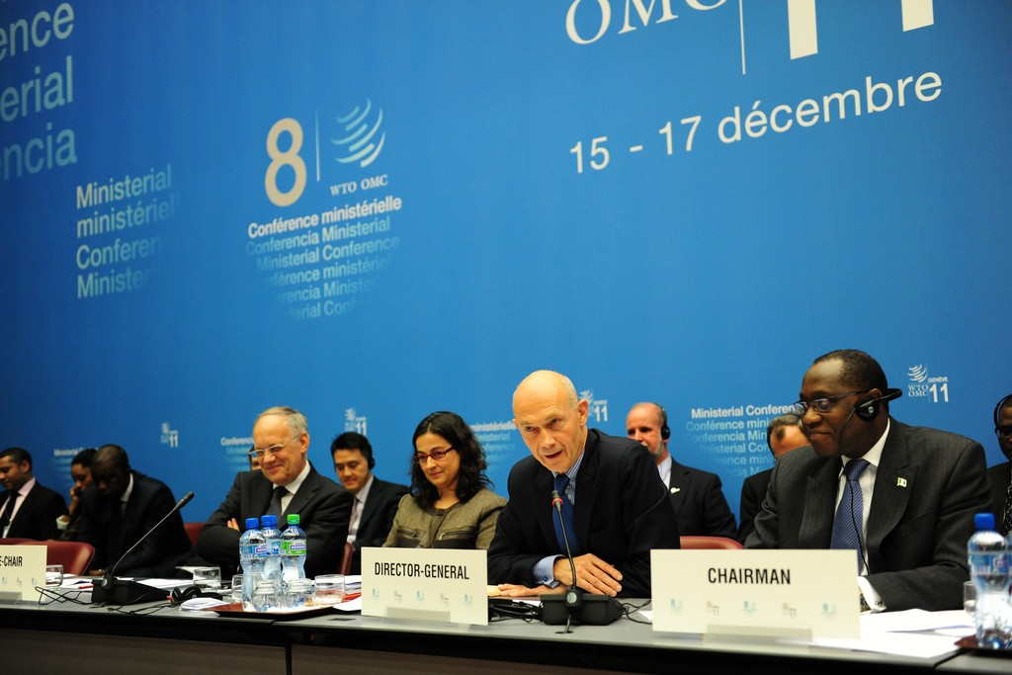
MC8 - Geneva Ministerial, 2011
Elements for Political Guidance
[…] Ministers recognize that Members need to more fully explore different negotiating approaches.

Slide 7
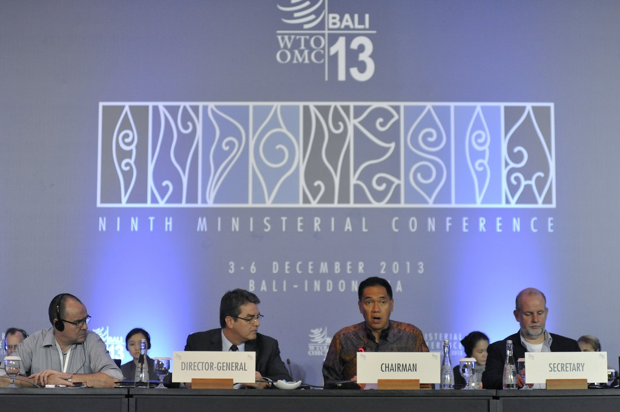
MC9 – Bali Ministerial, 2013
Agreement on Trade Facilitation (TFA)
Public Stockholding for Food Security Purposes
Single Undertaking

Slide 8
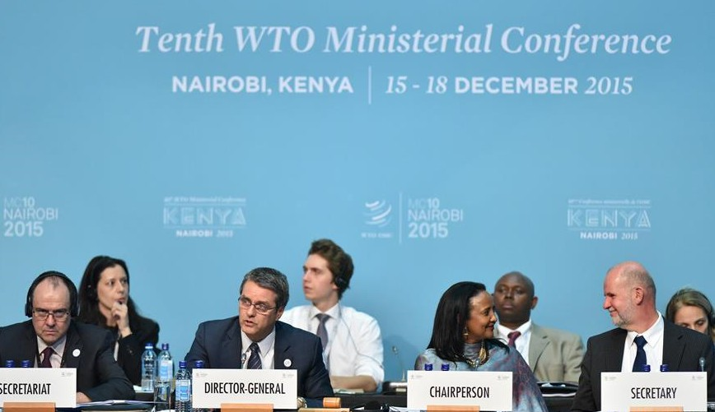
MC10 - Nairobi Ministerial, 2015
Elimination of agricultural export subsidies
“Many Members reaffirm the DDA […] Other Members do not reaffirm the Doha mandates, as they believe new approaches are necessary to achieve meaningful outcomes in multilateral negotiations. Members have different views on how to address the negotiations.”

Slide 9
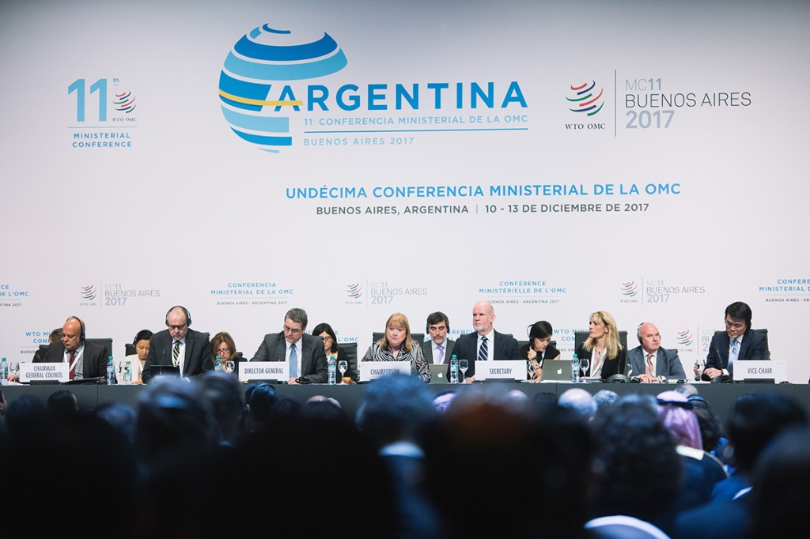
MC11 – Buenos Aires Ministerial, 2017
Joint Initiatives:
E-commerce
Investment Facilitation
MSMEs
Chairperson’s statement:
Not agreed

Slide 10
Ministerial Conferences
2011 – “Different Negotiating Approaches”
2013 – Agreements outside the Single Undertaking
2015 – Ditto, plus “different views” on negotiations
2017 – Joint Initiatives
Next - ?

Slide 11
Thank you

