Slide 1

Towards Transatlantic Regulatory Convergence in TTIP
Thomas Cottier
ELEC
Economic and Social Commission
Milan 17.6.2016

Slide 2
Background
Transatlantic Trade and Investment Partnership Agreement (TTIP) Negotiations between EU and US since 2013; completion expected 2016/2017
In parallel to TTP (completed 2015), mainly replacing transatlantic leadership in marking access negotiations of WTO due to multipolar power constellations

Slide 3
Comprehensive Coverage: 21st Century Gold Standards
Market Access
  Elimination of Tariffs, QRs (peak tariffs and agricultural tariffs)
  Services
  Government Procurement (including Federate and MS levels)
Regulatory “Behind the Border” Issues
  IPRs, competition, labour standards, environmental standards, energy, FDI

Slide 4
Non-tariff Barriers
Divergence of law creates obstacles to international trade due to
  Cultural differences in assessing and managing risks (perceptions and values)
    Example: EC-Hormones
  Different regulatory methods, procedures and traditions
    Example: Fuel efficiency standards

Slide 5
Adapters still needed …
Notes:
Jedes Land hat seine eigenen Steckdosen. Auswirkung auf Handel? Es gibt keinen Handel! Keine praktische Anwendbarkeit obwohl theoretisch handelsfähig. Beispiel einer technischen Vorschrift wie früher bei Autos → Kein Wettbewerb. Art von Protektionismus. Heute Verlagerung auf kartellrechtliche Ebene.
Seit 1993 CE-Kennzeichnung; Beschluss 93/465/EWG

Slide 6

Interconnection and Harmonization of Standards

Slide 7
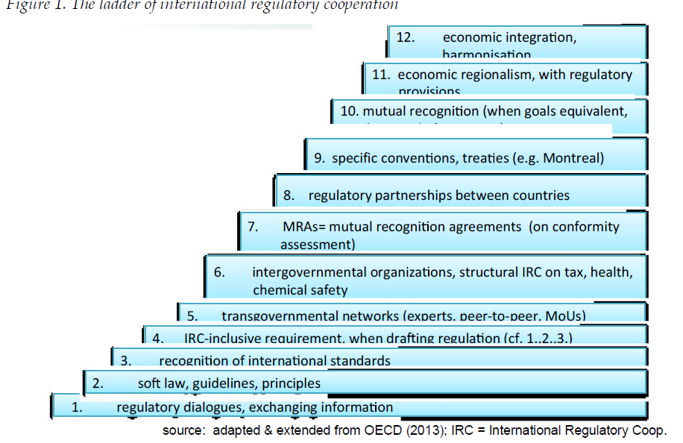

Slide 8
Foundations of Cooperation and Positive Integration in WTO Law
TBT Agreement
  Technical Regulation (Annex 2)
  Obligation to use international standards (Art. 2.4)
  Advanced notification and comments (Art. 2.9)
  Encouraging equivalence and MRAs (Art. 2.7 and 6.3) (implied MFN restriction)
  Transparency and Inquiry Points (Art. 10)
SPS Agreement
  Obligation to use international standards (Art. 3)
  Obligation to recognise equivalence (Art. 4)
  Transparency (Annex B)

Slide 9
Foundations of Cooperation and Positive Integration in WTO Law
TRIPs Agreement
  Most advanced instrument of global law in terms of international minimum standards applicable to all Member States, both on substance and in civil, administrative and penal procedures
GATT Article III National Treatment
GATS Agreement
  Transparency (Art. III)
  Domestic Regulation (Art. VI:4)

Slide 10
Relationship to WTO
TTIP builds upon the law of WTO and contributes to the common law of international trade
Referencing to WTO jurisprudence of panels and the AB
Exclusion of domestic subsidies in goods and services due to freeriding effects

Slide 11
TBT and SPS: EU Drafts 2015
Incorporation of TBT and SPS Agreements
Equivalence of SPS standards (Art. 9)
Obligation of exporting Country to meet importing Country SPS standards (Art. 13)
Obligation to cooperate to make standards compatible as far as possible (Art. 4 TBT)
Cooperation in IO towards global harmonization (Art. 4:3 TBT)

Slide 12
Recent Templates
CETA: Comprehensive Economic Trade Agreement, EU-Canada 2014
TTP, Transpacific Partnership Agreement 2015 (Australia, Brunei, Canada, Chile, Japan, Malaysia, Mexico, Peru, Singapore United States, Vietnam)
EU Korea FTA, US Korea FTA, EU Singapore FTA

Slide 13
CETA, Chapter 26 Art. X(2)(6)
6. The Parties may undertake regulatory cooperation activities, on a voluntary basis. For greater certainty, neither Party is obliged to enter into particular regulatory cooperation activities, and either Party may refuse to cooperate or may withdraw from cooperation. However, if a Party refuses to initiate regulatory cooperation or withdraws from such cooperation, it should be prepared to explain the reasons for its decision to the other Party.

Slide 14
TTIP: Cross-cutting disciplines and Institutional provisions
Position paper – Chapter on Regulatory Coherence (EU Commission 2013, undated)
“The TTIP provides a historic opportunity for the EU and the US to substantially enhance regulatory co-operation. Such co-operation should be guided by both Parties’ right to develop and maintain, policies and measures ensuring a high level of environmental, health, safety, consumer and labour protection, fully respecting the right of each side to regulate in accordance with the level of protection it deems appropriate. Closer regulatory co-operation is not only important to progressively achieve a more integrated transatlantic marketplace but also to ensure that the EU and the US jointly and actively promote the development of international regulations and standards in co-operation and dialogue with other partners, as well as ensure together in the most effective way the objectives at stake.”

Slide 15
Impact of Industry
Given the complex nature of each sector's respective regulatory issues, trade officials on both sides are taking their cues from industry on what goals should be pursued, one EU source said. Trade associations for the medical device industries of the U.S. and EU have already made a joint submission, and the machinery industry is currently in the process of developing joint recommendations, the source said.
"Generally when you have both industries across the Atlantic with concrete regulatory ideas, it is probably easier to make progress on the basis of engagement of regulators from both sides," he added.
Inside US Trade, September 12, 2013

Slide 16
Blueprint 2013
“On regulatory cooperation, priority sectors to be raised by the EU are medical devices, machinery, pulp and paper, railway, and aviation, sources said. These are in addition to chemicals, pharmaceutical and automobiles, which were mentioned as potential candidates in the High-Level Working Group (HLWG) report as particularly heavily traded sectors. The HLWG report was endorsed by both sides as the blueprint for the negotiations.”
Inside US Trade September 12, 2013

Slide 17
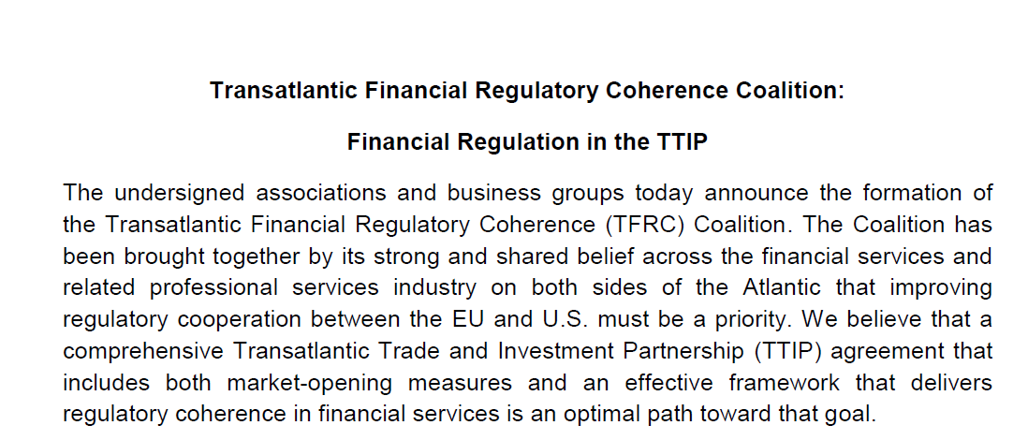
Impact of Financial Industry
Inside US Trade 7.6.2016

Slide 18
EC: TTIP: Equivalence and Cooperation (September 2013)
“Existing regulation can be tackled in different ways:
One idea would be to formally recognise that some regulations have broadly the same effect. This would mean that companies, under certain conditions, could simply comply with one set of rules in order to sell in both markets.
Another idea would be for both sides to move their regulation closer to internationally agreed ways of solving the problem at hand.
A third way to work, where EU and US regulations are very different, would be for regulators to cooperate more on how they put the regulation into practice.”

Slide 19
Transparency and Early Warning Systems
"For this to work to work effectively, it really needs to be done at a sufficiently early stage of the procedure. Because the moment that on the U.S. side you have already gone to a notice and comment, to a large extent the mind of the regulator is already made in terms of what it intends to do," [Commissioner de Gucht] said, adding that this is also true in the EU.
"This does not mean that they're going to be sharing drafts or anything like that," he said. "But it means that you have a serious regulatory dialogue that allows you to understand what the other side is envisioning in terms of regulation and how to try to ensure that unnecessary impacts are avoided." Trade agencies would also be involved, he said.
Inside US Trade, October 10, 2013

Slide 20
TTIP: Regulatory Convergence Draft 2015
Early information and hearings
Stakeholder consultation
Impact assessment
Possible extension to federal state level
Focal Points
Tools
  Mutual recognition of equivalence
  Harmonization by recourse to international standards or approximation
  Regulatory Cooperation Body (RCB)

Slide 21
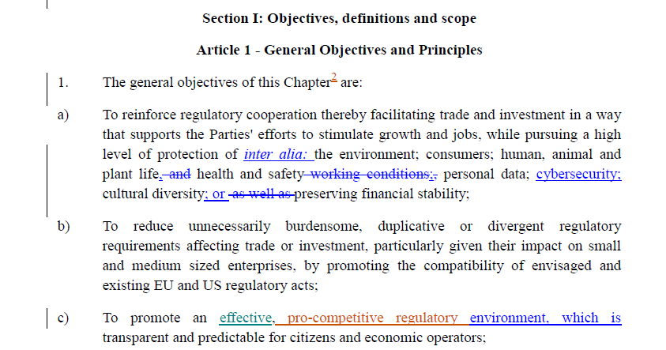
Objectives of Regulatory Cooperation 2015

Slide 22
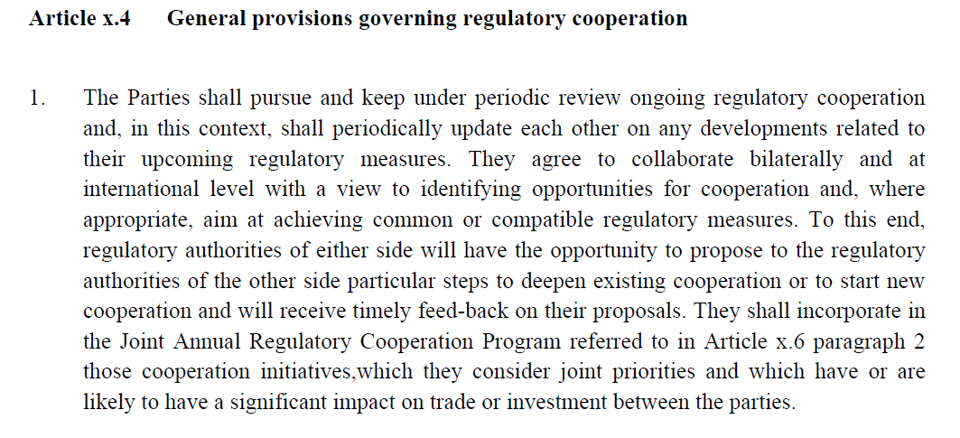
Draft 21.3.2016

Slide 23
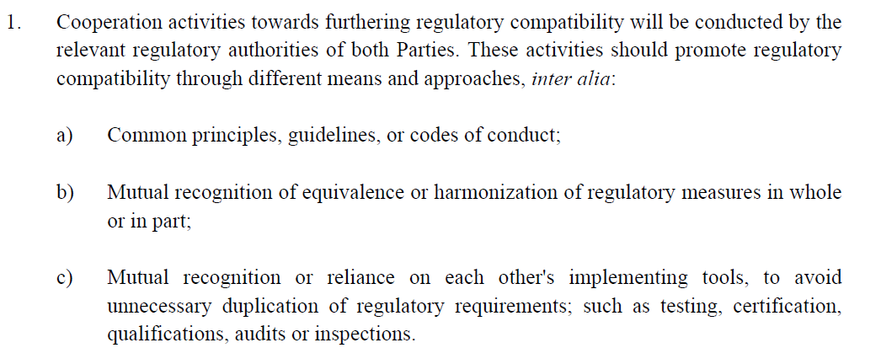
Art 5x Specific activities promoting regulatory compatibility (21.3.2016)

Slide 24
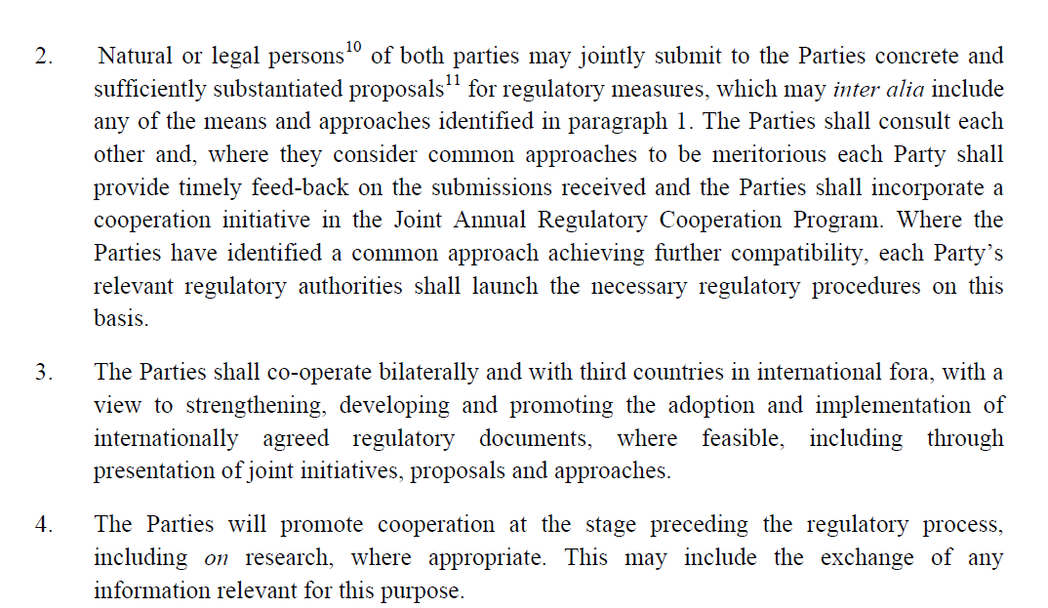

Slide 25
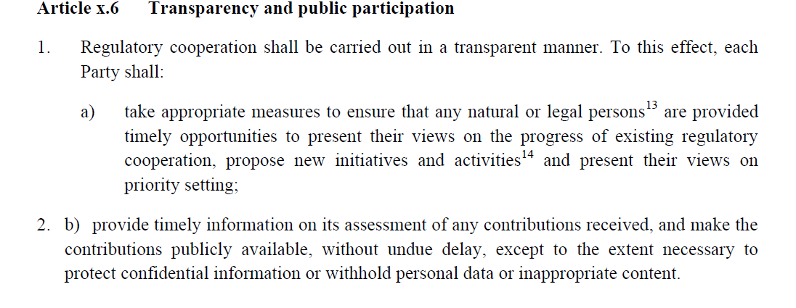

Slide 26
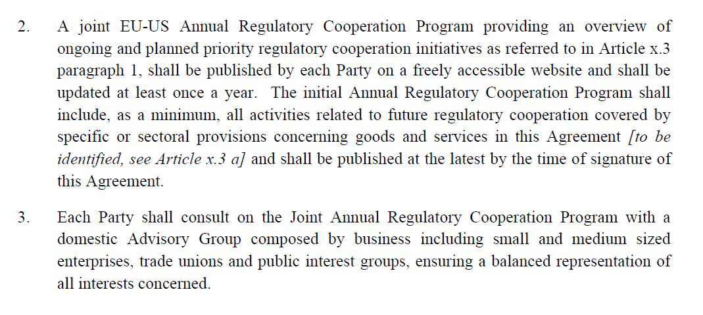

Slide 27
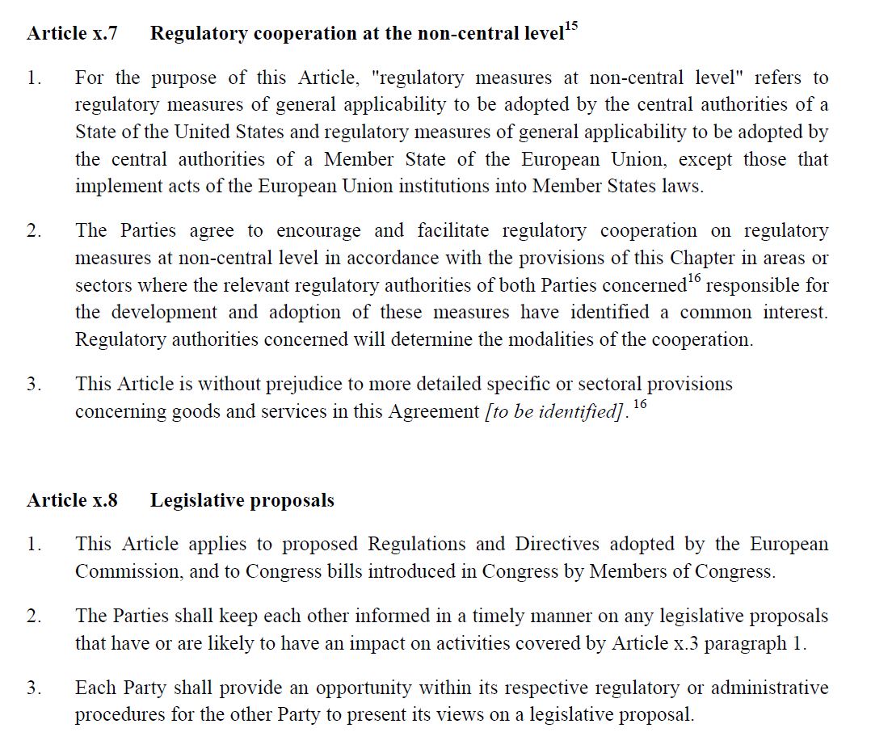

Slide 28
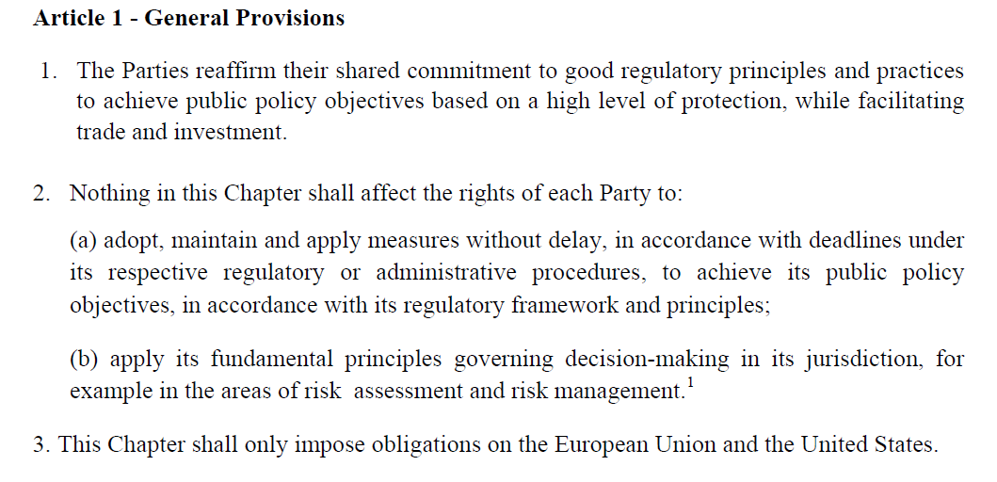
Good Regulatory Practices (21.3.2016)

Slide 29
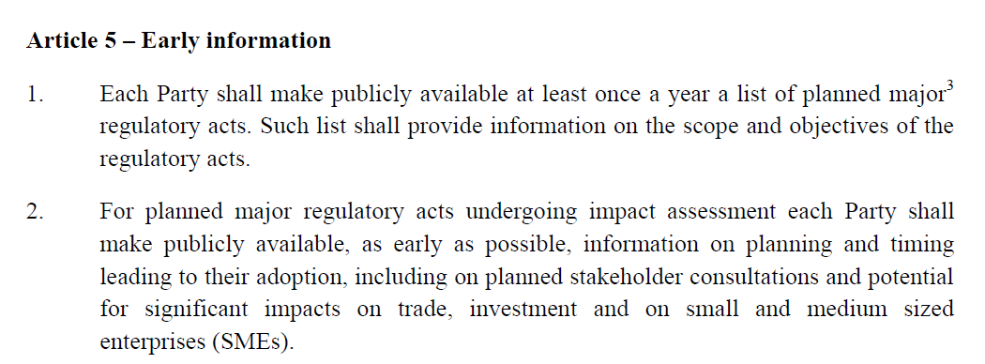

Slide 30
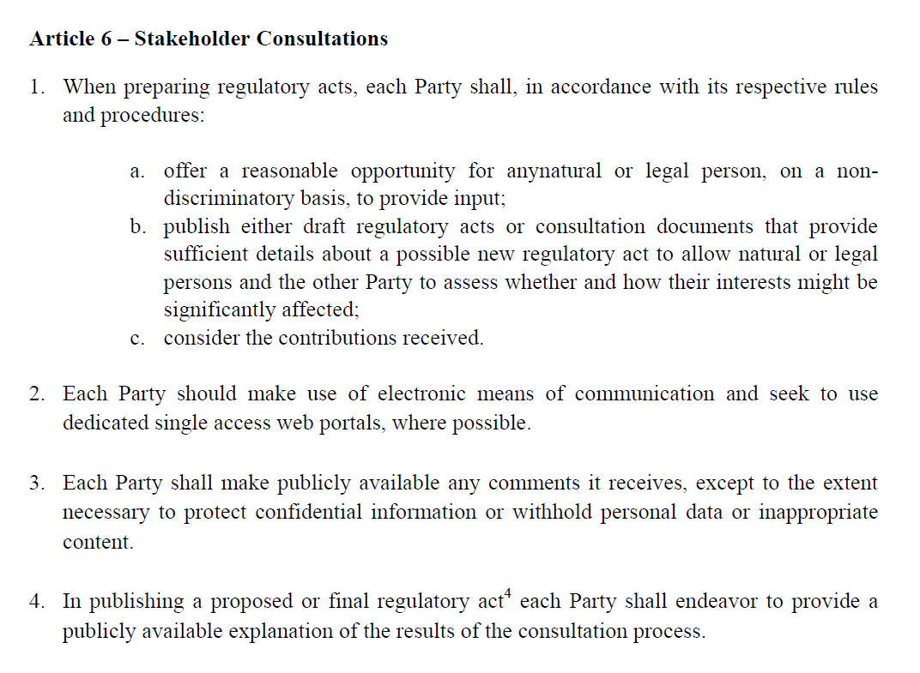

Slide 31
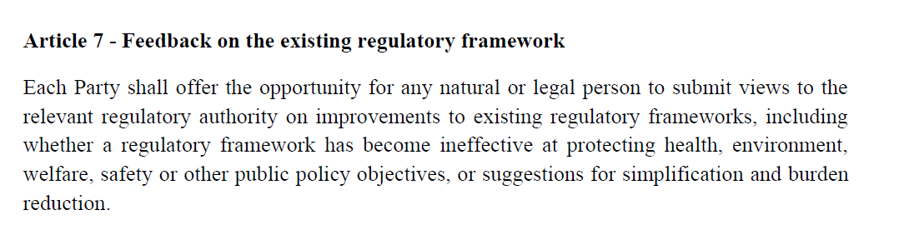

Slide 32
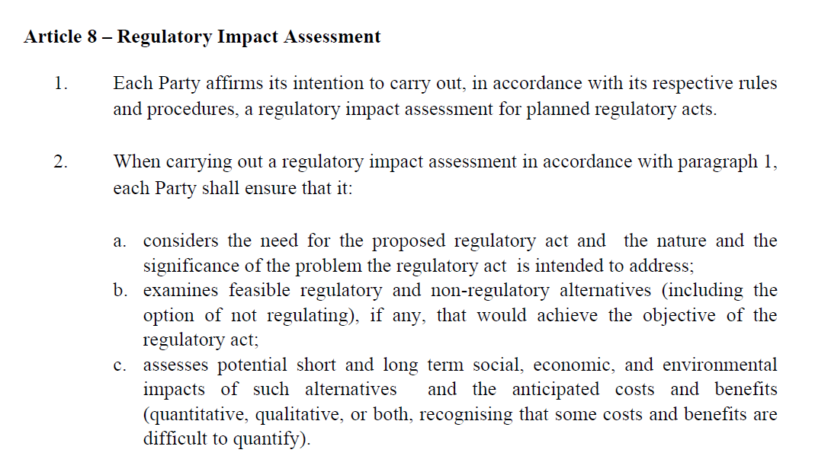

Slide 33
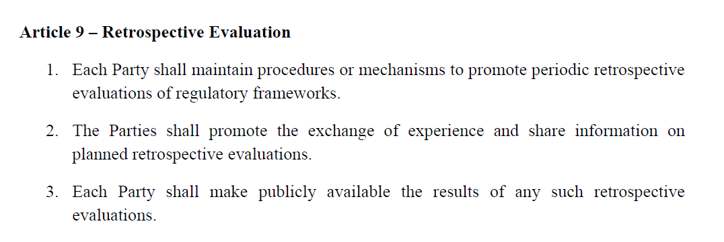

Slide 34
Domestic Concerns
“And let me be clear: the TTIP that the European Commission will negotiate and present for ratification will be an agreement that is good for citizens – good for growth and jobs here in Europe. It will be an agreement which strengthens Europe’s influence in the world, and which would help us protect our strict standards. The European Commission would never even consider an agreement which would lower our standards or limit our governments' right to regulate. Neither would EU Member States, nor the European Parliament”, said Cecilia Malmström. http://trade.ec.europa.eu/doclib/press/index.cfm?id=1234

Slide 35
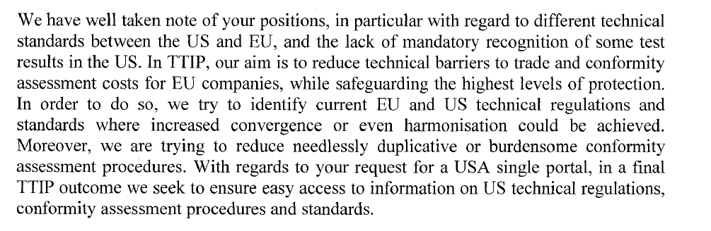
Assuring Objectives on TBTs
(Malström letter to ORGALIME 27.5.16 (Inside US Trade):

Slide 36
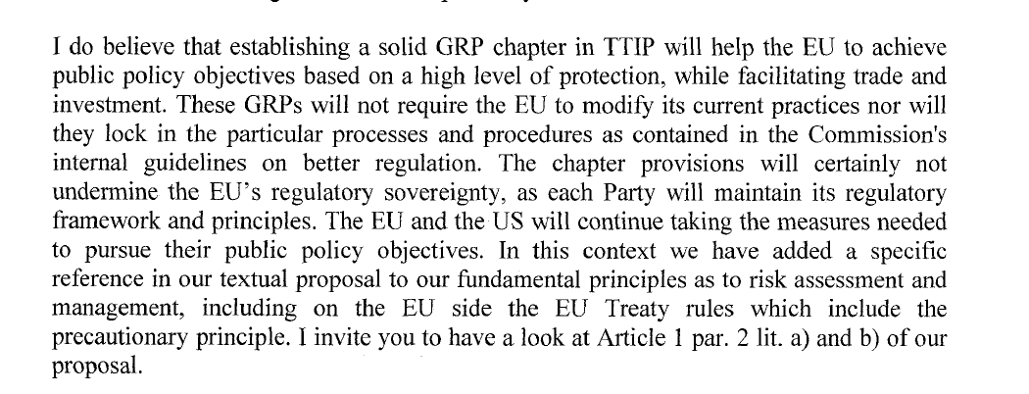
Assuring Objectives on GRP
(Letter Malström to Health and Environment Alliance, 27.5.16 (Inside US Trade)

Slide 37
Atlantic Differences
“The key difference however is that while keeping away from regulatory harmonization, the North American approach continues to be driven by a specific perception about the regulatory and standardization role of government that is markedly different from that of the EU (not least on such issues where differences in regulatory culture stem from approaches to scientific risk determination), a point which will inevitably leave an imprint on the CETA negotiations.” (Kristic at 6).

Slide 38
State of Play 2015
“Two years and nine rounds of negotiation later, TTIP’s regulatory component is one of the more contentious parts of the agreement, both because of persistent differences in emphasis between the negotiators, and because of concerns that regulatory cooperation could lead to a lowering – or, for that matter, an unjustified raising – of consumer, worker, prudential, and environmental standards.”
Chase and Pelkman 2015 at 1

Slide 39
Revised EU Regulatory Text Reflects Reforms, Falls Short Of U.S. Demands
February 25, 2016 (Inside US Trade 25.2.2016):
[But] the agenda did not change the EU's practice with regard to draft regulations and directives, which requires only that the European Commission publish "road maps" in advance of proposing legislation explaining how it seeks to address policy issues, and seek public comments in response. The language in the new text allowing covered bodies to comply by publishing "consultation documents" would appear to fit with this EU process.

Slide 40
Different Regulatory Traditions
US
Product liability and precautionary approach
Federal Government enforcement of Standards
EU
Precautionary Principle and strict liablity
New Approach 1984 and delegation to private sector regulation
Decentralised enforcement

Slide 41
Past Experience
In electrical goods safety, the third sector which failed (the MRA was suspended by the EU in 2003), the EU attempted in 2008 to convince OSHA (the US regulator for occupational health and safety, including electric goods and machinery used in the workplace) to accept SDoCs from EU producers. SDoCs are a form of self-certification customary in the EU ‘New Approach’ to reducing regulatory barriers in the single market. After a two-year investigation, OSHA concluded that the empirical evidence about equivalent or better risk reduction in the EU was insufficiently convincing. This experience underscores that regulators will only enter into agreements with their counterparts where hard evidence exists that both the rules and the enforcement of those rules demonstrate that the counterpart’s approach delivers similar regulatory outcomes.
Chase and Pelkmans at 7.

Slide 42
Constitutional Law Challenges
In behind the border and legislative issues, how to include the public and legislators in the process of convergence
Specialized national agencies responsible for enforcement
European Parliament
National Parliaments

Slide 43
Curb your Enthusiasm
Impact of VW scandal on NOX emissions exceeding standards up to 40 times?
Impact of Safe Haven Ruling of the European Court of Justice?
Impact of geopolitical differences in particular relating to national security and defence? Impact of November 13, 2015?

Slide 44
Conclusions
WTO plus mainly in the field of procedures and institutional arrangements
Regulatory cooperation and convergence likely to be long term process, requiring building of mutual trust and overcoming institutional bias in defence of domestic regulatory powers
Sectorial approach with converging industry interests most likely
Main challenges in integrating national law-makers and civil society in the process of global law making

Slide 45
Thank you for your attention
thomas.cottier@wti.org
Stanko S. Krstic, Regulatory cooperation to remove non-tariff barriers to trade in products: key challenges and opportunities for the Canada-EU comprehensive Trade Agreement (CETA) http://ssrn.com/abstract=2025509,
Peter Chase and Jacques Pelkmans, This time it’s different:Turbo-charging regulatory cooperation in TTIP Paper No. 7 in the CEPS-CTR project ‘TTIP in the Balance’ and CEPS Special Report No. 110 / June 2015
Bernhard Hoekman, Fostering Transatlantic Regulatory Cooperation and Gradual Multilateralization, 18 Journal of International Economic Law 609-624 (2015)
Thomas Cottier, The Common Law of International Trade and the Future of the World Trade Organization, 18 Journal of International Economic law 3-20 (2015).

