Slide 1
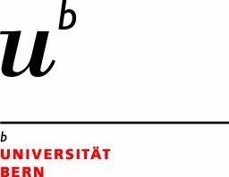

the internet as a governance challenge
mira burri, world trade institute
university of bern

Slide 2
the big Q: who controls the internet?

Slide 3
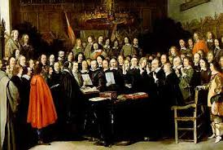
peace of westphalia, 1648

Slide 4
‘the first and foremost restriction imposed by international law upon a state is that – failing the existence of a permissive rule to the contrary – it may not exercise its power in any form in the territory of another state’.
Lotus (1927) PCIJ Ser. A No. 10

Slide 5
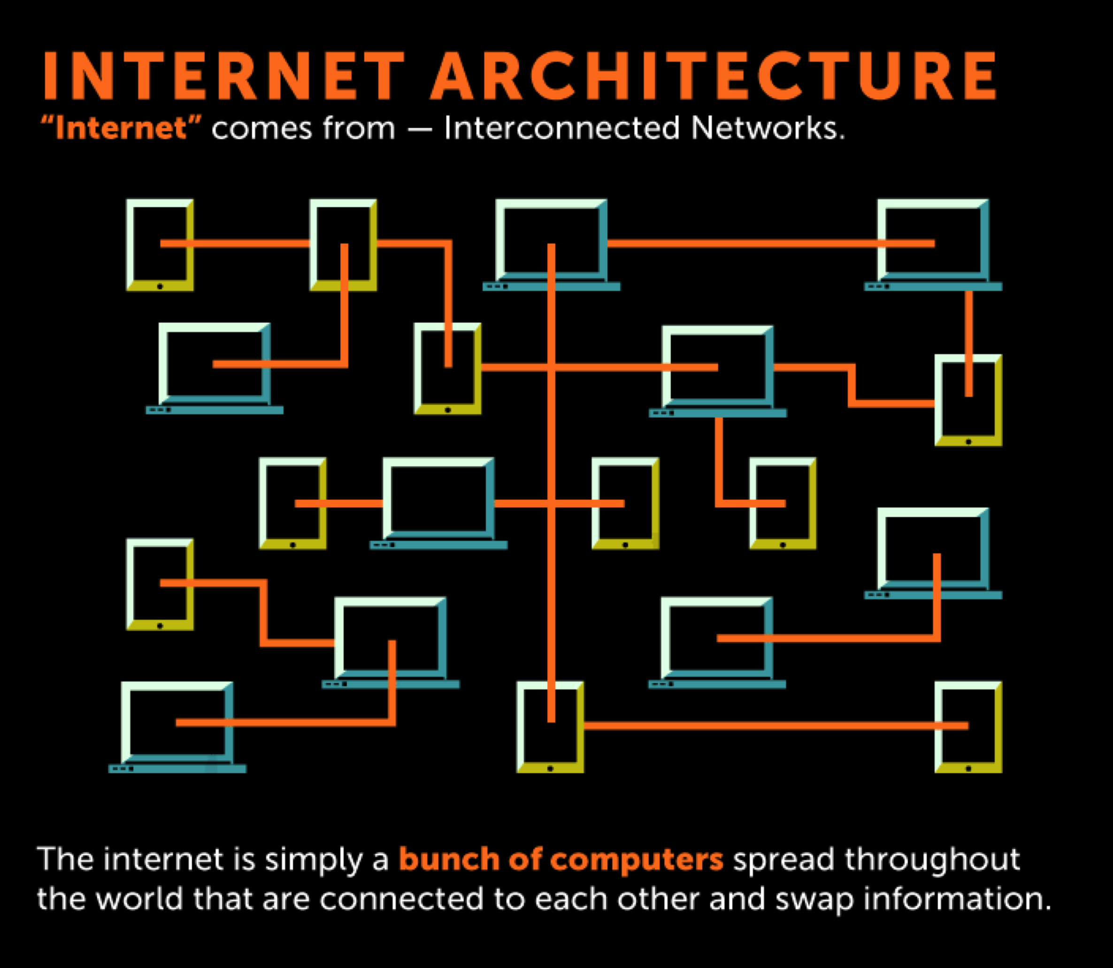
www.open-site.org

Slide 6
‘Governments of the Industrial World, you weary giants of flesh and steel, I come from Cyberspace, the new home of Mind. On behalf of the future, I ask you of the past to leave us alone. You are not welcome among us. You have no sovereignty where we gather’.
John Perry Barlow, A Declaration of the Independence of Cyberspace (Davos 1996)

Slide 7
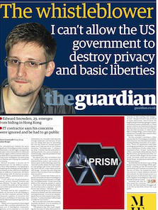

Slide 8
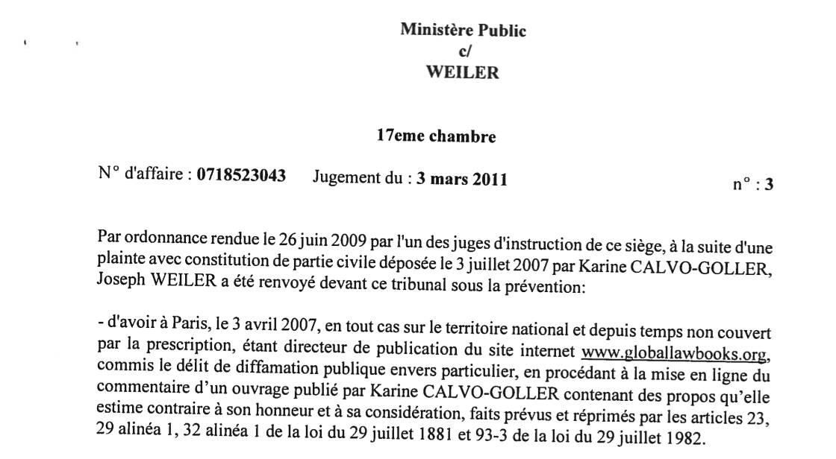

Slide 9
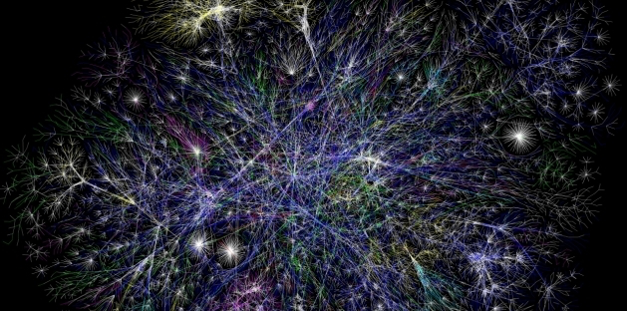
partial map of the internet based on 15 jan 2005 data (opte project, via wikimedia commons)

Slide 10

Big companies dominate and control our communications.
#Facebook #Google #commercialization

Slide 11
ICANN is not accountable to anyone but the US.
#totalcontrol #theENDofinternationalLAW

Slide 12
Our fundamental citizens’ rights, such as freedom of expression and privacy, are infringed on a daily basis.
#Facebook #Google #dontforgetsnowden

Slide 13
Our citizens are getting too much of this and this, and not engaging in meaningful political deliberation.
#mainstream #digotaleyeballs #forgetdigitaldemocracy

Slide 14
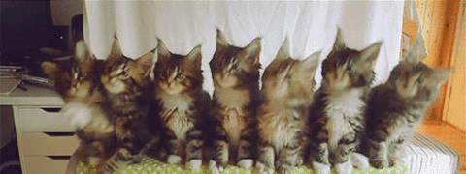

Slide 15



Slide 16
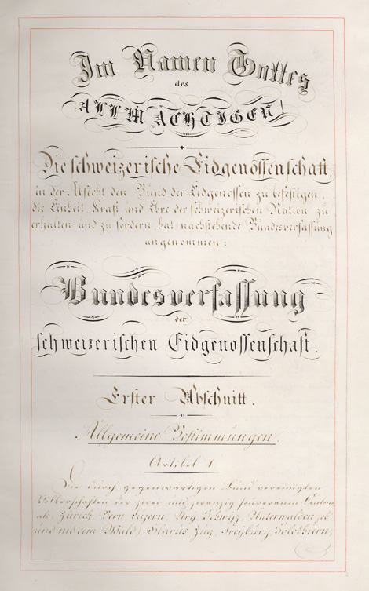

Slide 17
Our citizens are getting too much of this and this, and not engaging in meaningful political deliberation.
#mainstream #digotaleyeballs #forgetdigitaldemocracy

Slide 18
the big Q: who controls the internet?

Slide 19
the big Q: who controls the internet?

Slide 20
the internet is not A thing

Slide 21
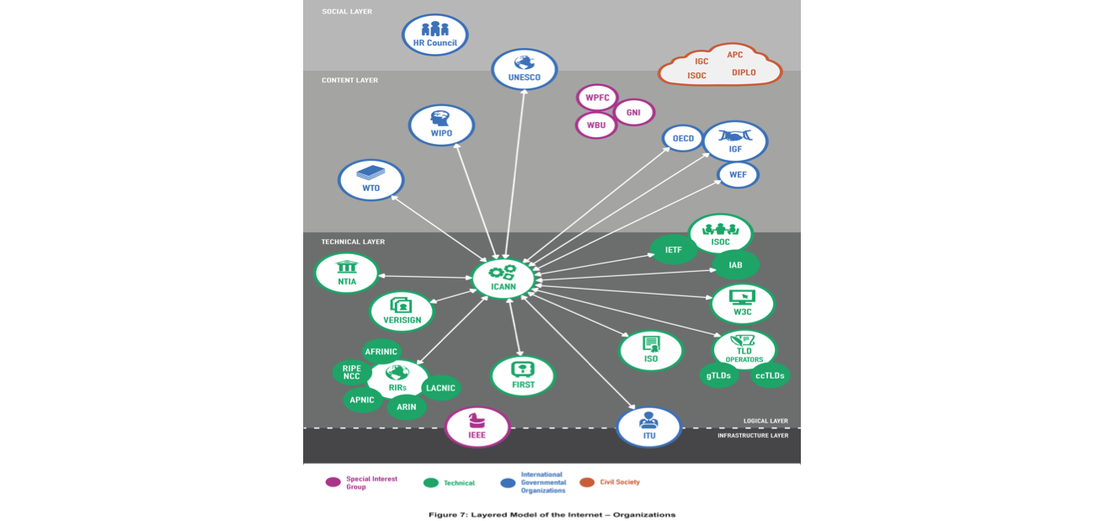
icann, 2014

Slide 22
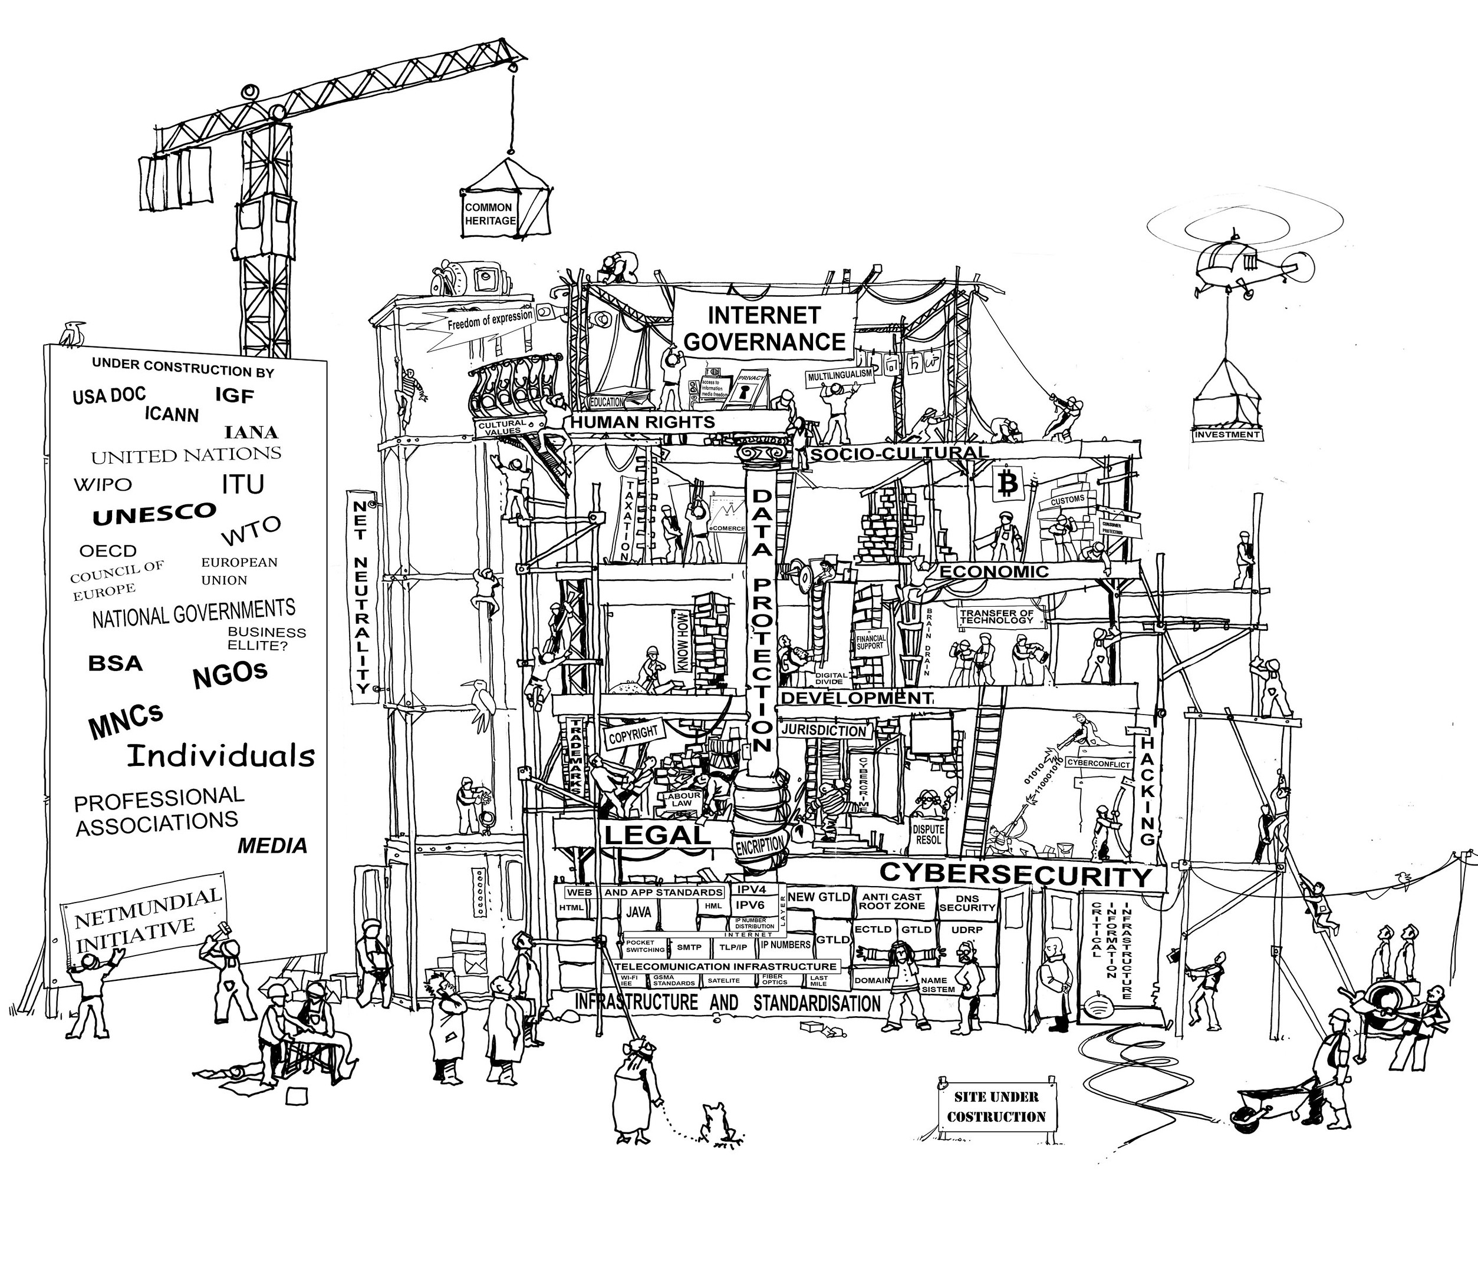
diplo, 2014

Slide 23
deal with complexity

Slide 24
deal with complexity cooperate

Slide 25
deal with complexity cooperate take the long-term perspective

Slide 26
deal with complexity cooperate take the long-term perspective do no harm

Slide 27
thank you. contact: mira.burri@wti.org

