Slide 1

Joachim Monkelbaan:
Some time in Trade and
Climate Change space
Bern, Friday 5 December 2022

Slide 2

List of career and educational hiccups:
Dropped out of university
Dropped out of PhD programme
Career crises in 2006, 2009, 2014, …..
Introductions
Joachim Monkelbaan
Lead, Climate Trade
World Economic Forum

Slide 3
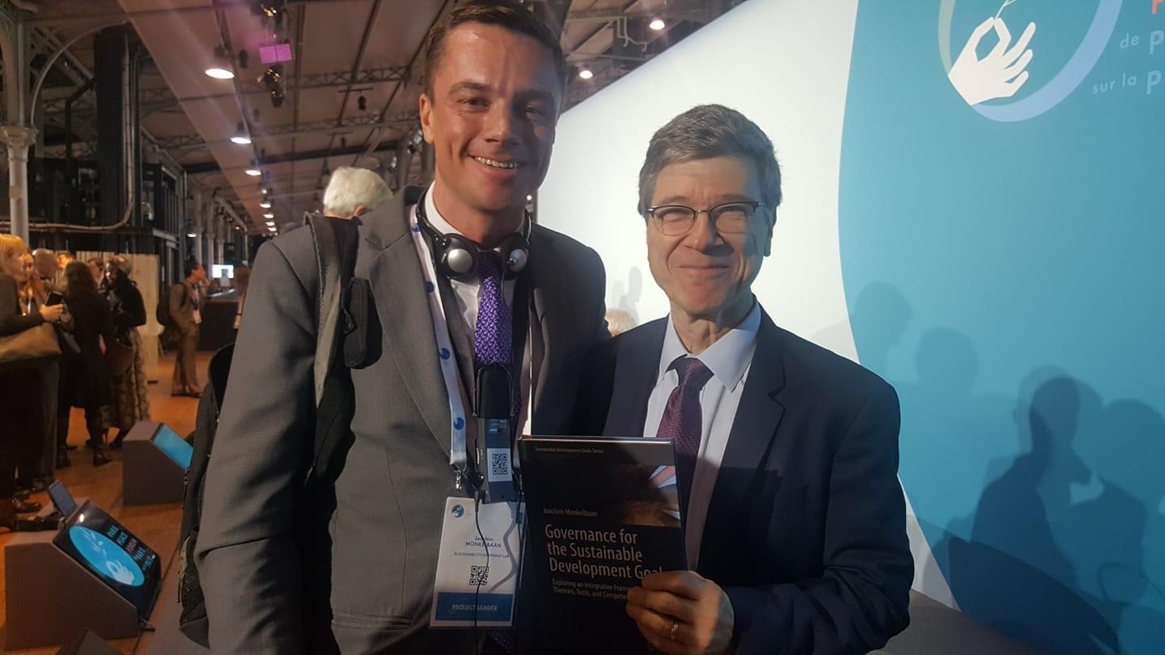
List of career and educational steps:
Maastricht University (European Law and Languages) and WTI (MILE 4)
Trainee at ITC and Council of Ministers (EU, Trade Committee)
Dutch Ministry of Economy and Climate
IUCN, Global Policy Unit and China
ICTSD, UNEP, Team Leader for EU SIAs
PhD in sustainability governance, University of Geneva, post-docs at UCLA and IDE-JETRO
Climate-KIC, QUNO, and WEF
Joachim Monkelbaan
Lead, Climate Trade
World Economic Forum

Slide 4
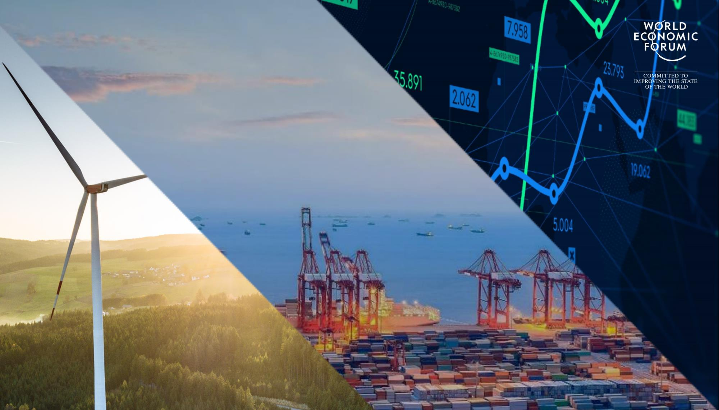
Platform for Shaping the
Future of Trade and Investment

Slide 5
Shaping the future of trade and investment
OUR MISSION
Global growth is increasingly complex and volatile.
The COVID-19 pandemic and invasion of Ukraine were shocks to global markets already strained by geopolitical, social and trade tensions.
Yet there are also growing opportunities across geographies and sectors.
How do businesses and governments ensure functioning and sustainable global markets?
Our Platform informs business and policy action on critical international trade and investment choices.
We drive growth and development by working with companies, governments, and civil society.

Slide 6
Over 120 Partners from more than 20 industries
OUR COMMUNITY
A.P. Møller-Maersk A/S
Adani Ports and Special Economic Zones
Abu Dhabi Developmental Holding Company
Agility
Alibaba Group
Amazon
AMTD Group
Angelicoussis Group
Apex-Brasil
Apollo Tyres
Apple
AREA42
ArcelorMittal
Bahrain EDB
Bain & Company Inc.
Bajaj Holdings & Investment Limited
Baker McKenzie
Banco BTG Pactual SA
Bank Gospodarstwa Krajowego
Bank of Montreal
BASF SE
Bharti Airtel Limited
Black Lake
Brand South Africa
BTC Africa S.A.
Burjeel Holdings
C2FO
Cargill
Cedar Holdings Group
CF Industries Holdings Inc.
Citi
Circulor
CPP Investment Board
Crowdz
Dell Technologies
Deutsche Post DHL Group
DNB ASA
Dorae
Dow
DP World Limited
Eastern Networks (EastNets)
Ecopetrol SA
EMQ
EBRD
Evermos
ECIC of South Africa
EY
Fashnear Technologies Private Limited
Flexport
FOMO Pay
GIC Private Limited
Glencore International
Global 66
Google
Government of Flanders
Henry Schein
Hero Group
Hong Kong Exchanges and Clearing Limited
HP Inc.
HSBC Holdings
Huawei Technologies Co.
Hugo
Hyundai Motor Group
IBM Corporation
Indorama Ventures
Integral Group
Intel Corporation
Intercorp Peru Ltd
Invest Saudi
IPA Qatar
Islamic Development Bank
Japan External Trade Organization
KPMG
Luksic Group
Mastercard
Merck KGaA
Meta Platforms Inc.
Microsoft Corp.
Mitsubishi Chemical Group Corporation
Moelis & Company
Nestlé
OC Oerlikon Management AG
Oman Global Logistics Group SAOC
PAG Holdings Limited
Palantir Technologies Inc.
PayPal
Pfizer
Pula Advisors
PwC
Qatar Financial Centre Authority
Qatar Investment Authority
Rakuten Group, Inc.
Resilinc
Robert Bosch GmbH
Saudi National Bank
Sempra
Sharjah Investment and Development Authority
Shippo
Sokowatch
Solvay SA
Sonangol EP
Standard Chartered Bank
Suade
Sumitomo Mitsui Financial Group
Telefonaktiebolaget LM Ericsson
Temasek International Pte Ltd
Tencent Holdings Limited
The Western Union Company
Tradeshift
Tradeteq
Tyson Foods
UPS
Vale SA
Visa Inc.
Walmart Inc.
WorldBridge Group of Companies
Zilingo Pte Ltd
Zoom Video Communications, Inc.
Zyllem

Slide 7
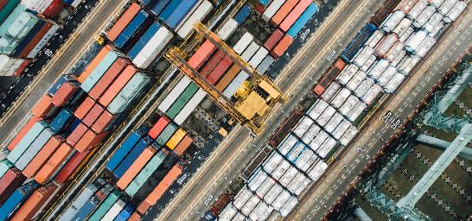
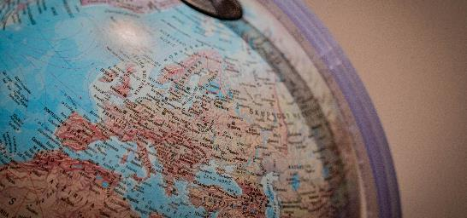
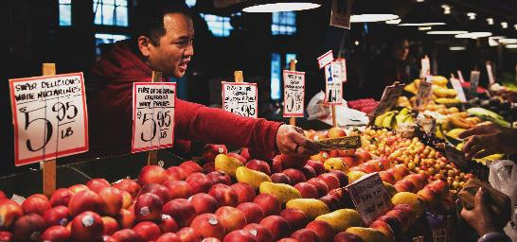



Our community’s priorities
TRADE AND INVESTMENT
Ensuring open and resilient markets
Easing physical and digital flows
Supporting equitable and sustainable value chains
Engaging business and policymakers to tackle geo-commercial challenges, including the role of the state in the economy, and build interoperable trade and technology governance frameworks.
Increasing the quality and quantity of foreign direct investment (FDI), including digital investment.
Delivering business-driven border reforms to drive economic development and poverty reduction while cutting costs and risk for business.
Applying new technologies to flows of information, finance and payment, unlocking new opportunities for digital trade, e-commerce and global supply chain management.
Making global supply chains greener, and ensuring trade supports environmental and climate action worldwide.
Improving access to the benefits of trade for workers and disadvantaged communities, including Indigenous Peoples.

Slide 8
Platform Architecture
TRADE AND INVESTMENT
PILLARS
Ensuring open and resilient markets
Supporting equitable and sustainable value chains
Easing physical and digital flows
Trade Facilitation
Trade and Investment Leadership Group
Trade Finance Frontiers
Green Trade
Trade and Investment Action Group
Global Investment Policy and Practice
Inclusive Trade
Digital Payments
Trade Shocks, Tensions and Governance
Strategic
Guidance
Workstreams
(examples)
Innovative
Thinking
Global Future Council on Trade and Investment
Highlighted workstream

Slide 9
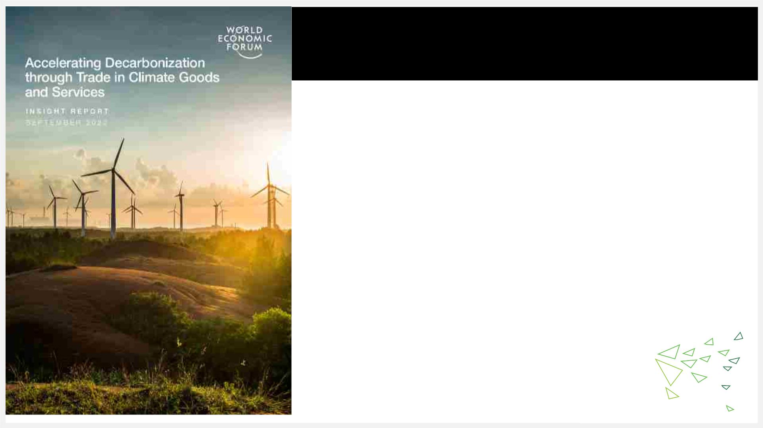
Topic 1:
Trade in climate goods and services
NEW! Report on trade in climate goods and services
(published in September 2022 in New York, alongside UNGA):
• 25 categories of goods that will help industry decarbonization, covers
items like alternative refrigerants, wind power, efficient motors etc.
Includes a short list of relevant examples, as well as a longer list of inputs

Slide 10
Findings
• Tariffs: declined to about 2% on average (0,5% in developed economies)
but peaks remain in some countries for some items, plus ITA and FTAs
• But cumulative impact of tariffs (supply chains)
• NTBs: - TBTs: standards, technical regulations and labeling + conformity
assessment procedures
- LCRs (Art.III GATT and SCM Agreement)
- Government procurement procedures (GPA, LCRs)
• Example: classification and standardization of green hydrogen
• Short and long list of suggested goods on our website, indispensable services
• Developing: just and inclusive transition, green jobs, need for capacity
building, EPPs
• Next steps: TESSD, ACCTS, FTAs, APEC

Slide 11
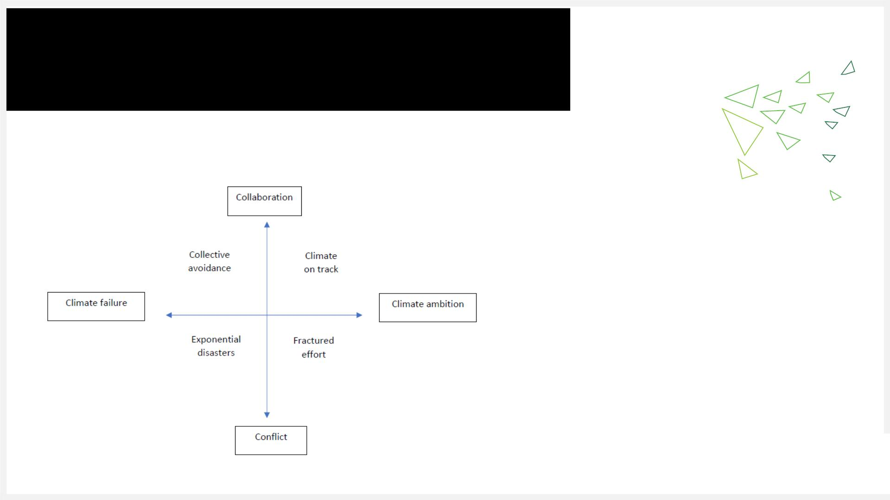
Topic 2:
Carbon competitiveness
What might carbon pricing and trade relations look like by 2030?
In each scenario:
1. What is happening to trade relations?
2. What is happening on climate action?
3. What is the role of country?

Slide 12

Topic 3:
Climate FDI
Climate FDI Facilitation
Guidebook
COP27
Climate FDI Facilitation pilot
countries
Guidebook ideas discussed at COP27,
for feedback and finetuning, and to
build awareness among the climate
community
Identifies a set of measures to
facilitate climate FDI, outlines
how these can be implemented
through public-private
Pilot specific measures from the
guidebook, in partnership with
Investment Promotion Agencies
(IPAs) in emerging economies
cooperation

Slide 13
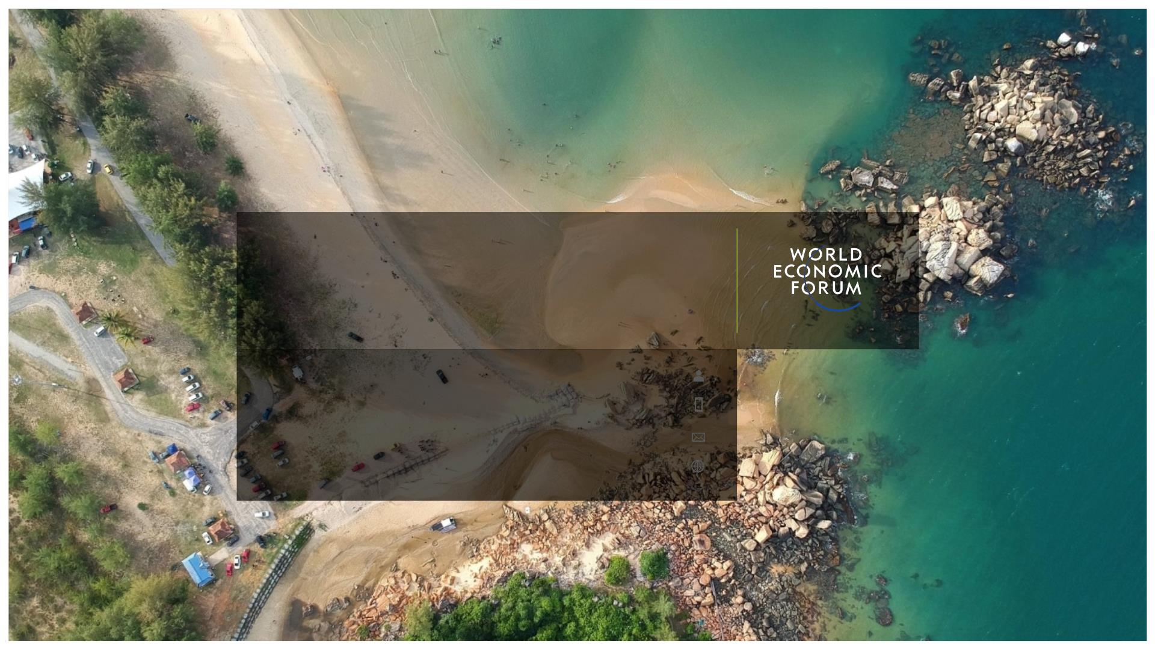
Thank you
Get in touch
jmon@weforum.org

