Slide 1
Understanding the economics of services trade
Pierre Sauvé
Macroeconomics, Trade and Investment Global Practice
psauve@worldbank.org
World Trade Institute, Bern
13 March 2019

Slide 2
What role will services play in addressing major societal challenges?
2
Human capital enhancement Y = f(K, L, (T))
Reducing mass poverty
Mitigating climate change, green energies and their financing
Designing intelligent cities and work places
Nurturing the revolution in life sciences
Inventing intelligent forms of mobility (transportation)
Investing in the digital society – E-commerce, E-governance, E-health
Each one of these meta challenges will require major doses of innovation in product design and delivery platforms, and the efficiency with which services – finance, ICT, business services, architecture, engineering, design, R&D, education – are delivered will be key in addressing these challenges
Responding to these challenges will also create vast new trade and investment opportunities, with or without trade agreements.

Slide 3
Contextual considerations about services and services trade
Services have been around for a while…but as an object of economic diplomacy, they remain relatively new, less than 3 decades old!
A subject matter still infused with strong doses of learning by doing and plagued by continued (if lessening) data inadequacies
Novelty almost always and everywhere breeds precaution in human beings, and trade negotiators (and regulators) are no exception to the rule
Precaution is supplied in abundance in services given the regulatory nature of impediments to market access

Slide 4
Contextual considerations
Services are largely – and increasingly - indifferent to the border – indeed to time and space constraints, significantly more so than for goods thanks to digitization.
Services are inclusive, supplying 3 in 5 jobs women occupy worldwide, a 40% increase over two decades.
The minimum efficient scale for regional and global competitiveness is markedly smaller for services, favouring trade by MSMEs and their insertion in GVCs.
The border remains a challenging place for Mode 4 and transport-related transactions, even within preferential confines.

Slide 5
Economic importance of services
Services are central and growing in importance in relation to:
Domestic economies and global production & employment
International trade and investment

Slide 6
Key Determinants of Service Sector Growth
Technological change
Production fragmentation
The growth of FDI
The supply of human capital
Changes in demand patterns
Ideology
6

Slide 7
Defining characteristics of services
Intangible
Non-storable
Intermediates
Protected behind borders
Highly regulated
Diverse
7

Slide 8
Share of Services in GDP, 2017, selected countries

Slide 9
Share of Services in GDP, 2017
50%-60%
KSA (52.5)
Cameroon
Kyrgyz Rep.
Malawi
Mongolia
Nigeria
Thailand
Zambia
Belarus
Uganda
60%-70%
Argentina
Bosnia & Herz.
Chinese Taipei
Mexico
Chile
Sri Lanka
Serbia
Philippines
<50%
Lao PDR
Viet Nam
Cambodia
Myanmar
Togo
>70%
Mauritius
Singapore
Costa Rica
Saint Kitts & Nevis

Slide 10
Servicification: evolution of services as % of GDP

Slide 11
World trade of goods and commercial services, billion USD 1995-2017
23%
19%

Slide 12
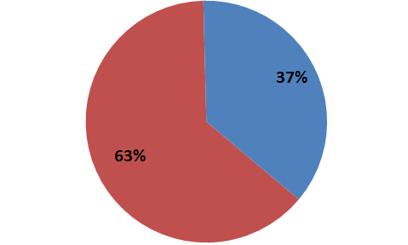
The share of developing countries’ services
trade is increasing
2017
Developing and transition economies
Developed countries

Slide 13
Leading services exporters, 2017 (billion USD and %)
Rank
Exporters
Value
Share
1
Extra-EU(28)
1009
25.2
2
United States
762
19.0
3
China
226
5.7
4
India
183
4.6
73%
of world
exports
5
Japan
180
4.5
6
Singapore
164
4.1
7
Switzerland
119
3.0
8
Hong Kong ,China
104
2.6
9
Korea, Rep. of
86
2.2
10
Canada
86
2.1
11
Thailand
75
1.9
12
U.A.E.
70
1.7
13
Australia
64
1.6
14
Russian Federation
57
1.4
15
Chinese Taipei
45
1.1
Notes:
13

Slide 14
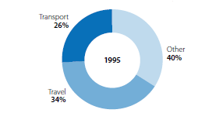
Exports of commercial services by main category and by sub-sector, 1995

Slide 15
World exports of commercial services by sector, 2017

Slide 16
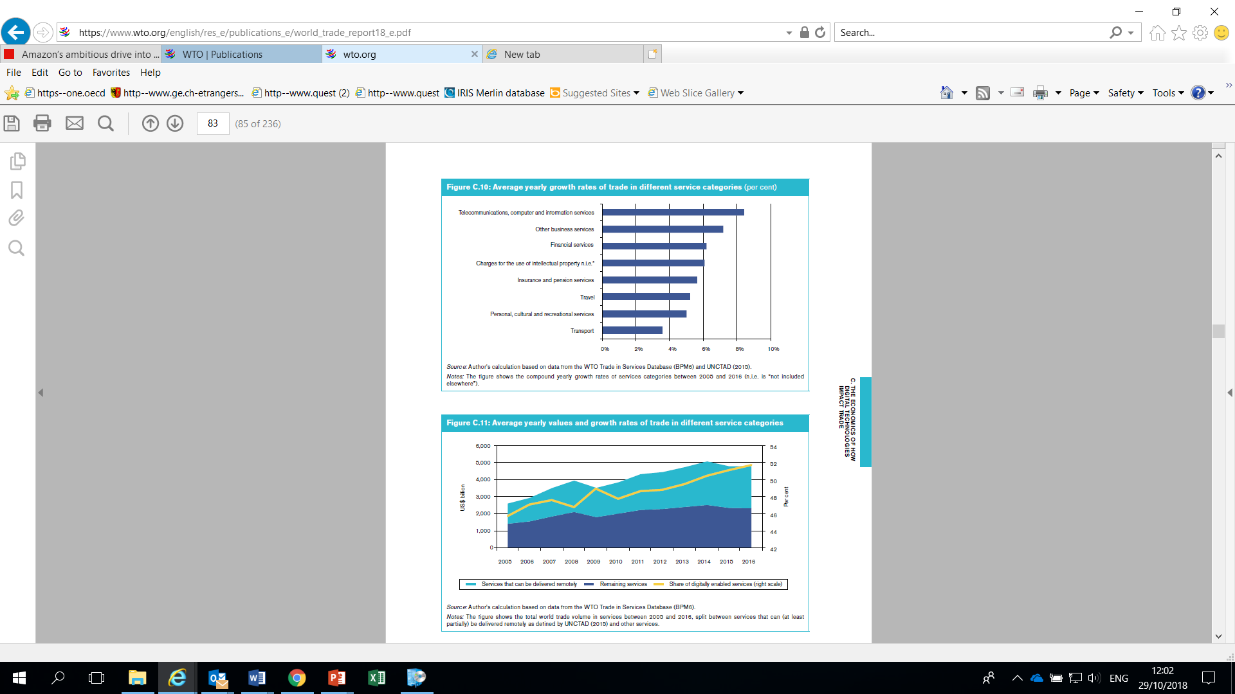
Average yearly growth rate of trade in different services categories, 2005-2016
Source: WTO
Notes:
A report by UNCTAD identifies a list of "ICT-enabled
services", which is aggregated into different services
sectors in Figure C.9. Consistent with what has long
been observed in services trade, the services that
can be delivered remotely over ICT networks are
telecommunications, sales and marketing, insurance
and pensions, finance, and intellectual property (IP)
services. Many of these service sectors have indeed
been leaders in adopting ICT technologies in the past
decades.
Technological advances and increased crossborder
tradability have led to significant changes
in the composition of trade in services. The fastest
growing service exports since 2005 are digitallyenabled
services such as telecommunications,
computer and information services, other business
services and financial services. Figure C.10 shows
that trade in these service sectors is growing much
faster than traditionally traded services such as
travel or transport. This is not surprising, as digitallyenabled
services have benefited significantly from the
increased efficiency of digital networks arising from
technological advances. The cross-border supply
of these services offers potential for new export
opportunities and for export diversification. Figure
C.11 illustrates the evolution of services trade: since
2014, trade in potentially digitally-enabled services
has accounted for more than half of total trade in
services.
Beyond the effect of lowering communications costs,
digital technology opens up new channels through
which services can be delivered. Services that
require more than just timely communication over the
internet or phone are now tradable across borders
through innovative business models that leverage
digital technology.

Slide 17
Average yearly values and growth rates of trade in different services categories, 2005-2016
Source: WTO
Notes:
A report by UNCTAD identifies a list of "ICT-enabled
services", which is aggregated into different services
sectors in Figure C.9. Consistent with what has long
been observed in services trade, the services that
can be delivered remotely over ICT networks are
telecommunications, sales and marketing, insurance
and pensions, finance, and intellectual property (IP)
services. Many of these service sectors have indeed
been leaders in adopting ICT technologies in the past
decades.
Technological advances and increased crossborder
tradability have led to significant changes
in the composition of trade in services. The fastest
growing service exports since 2005 are digitallyenabled
services such as telecommunications,
computer and information services, other business
services and financial services. Figure C.10 shows
that trade in these service sectors is growing much
faster than traditionally traded services such as
travel or transport. This is not surprising, as digitallyenabled
services have benefited significantly from the
increased efficiency of digital networks arising from
technological advances. The cross-border supply
of these services offers potential for new export
opportunities and for export diversification. Figure
C.11 illustrates the evolution of services trade: since
2014, trade in potentially digitally-enabled services
has accounted for more than half of total trade in
services.
Beyond the effect of lowering communications costs,
digital technology opens up new channels through
which services can be delivered. Services that
require more than just timely communication over the
internet or phone are now tradable across borders
through innovative business models that leverage
digital technology.

Slide 18
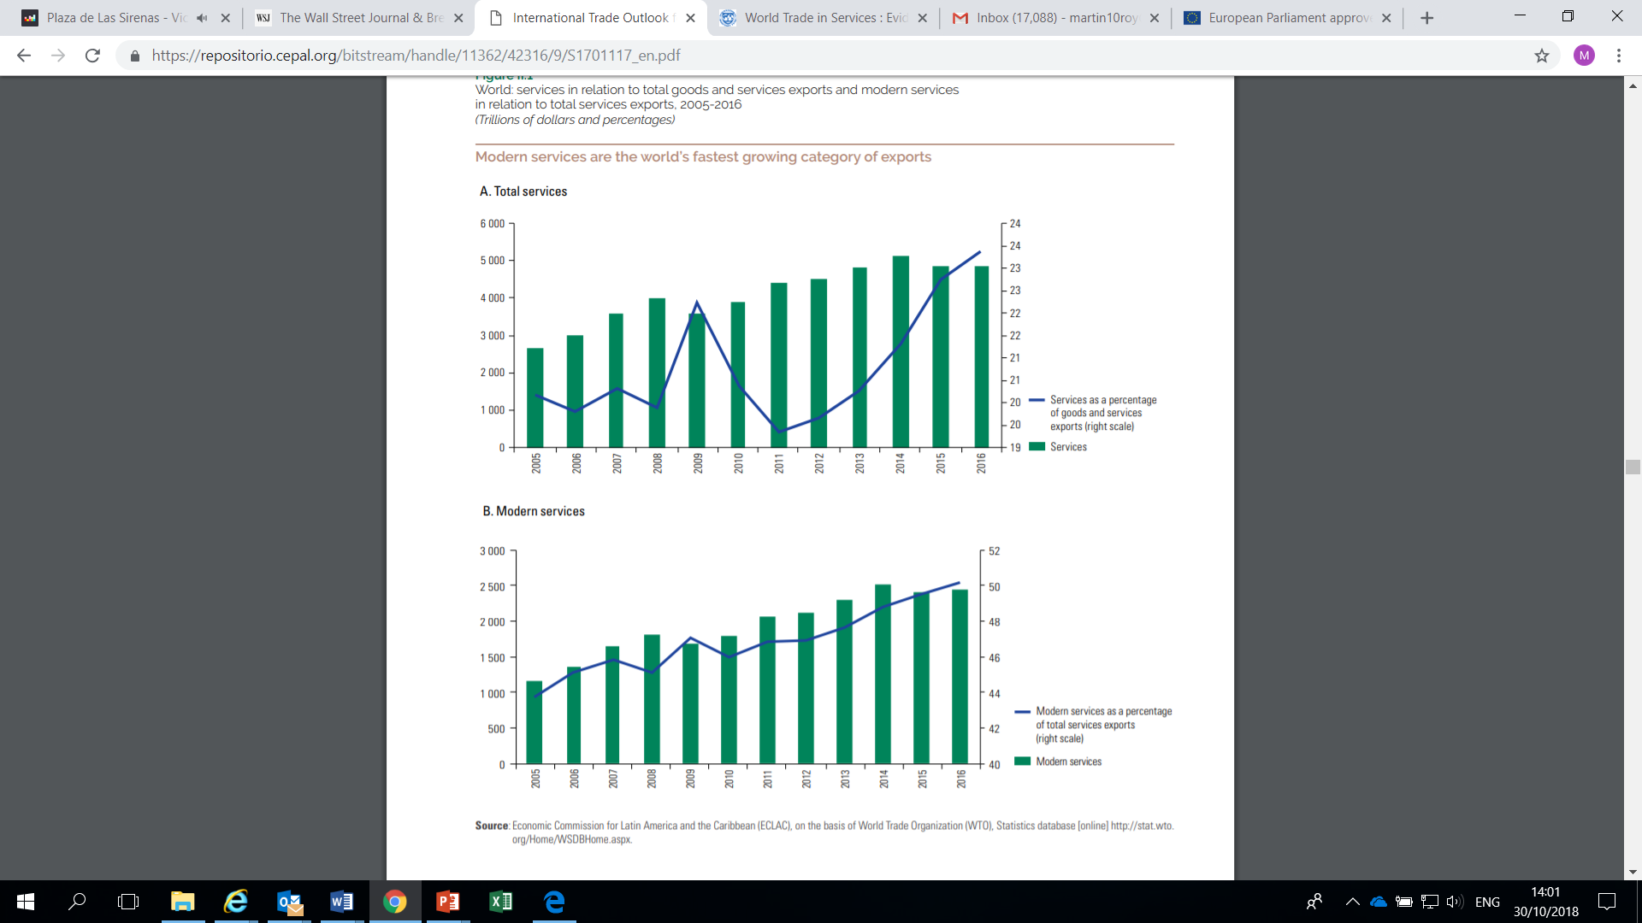
The growth of “modern services”
Source: ECLAC

Slide 19
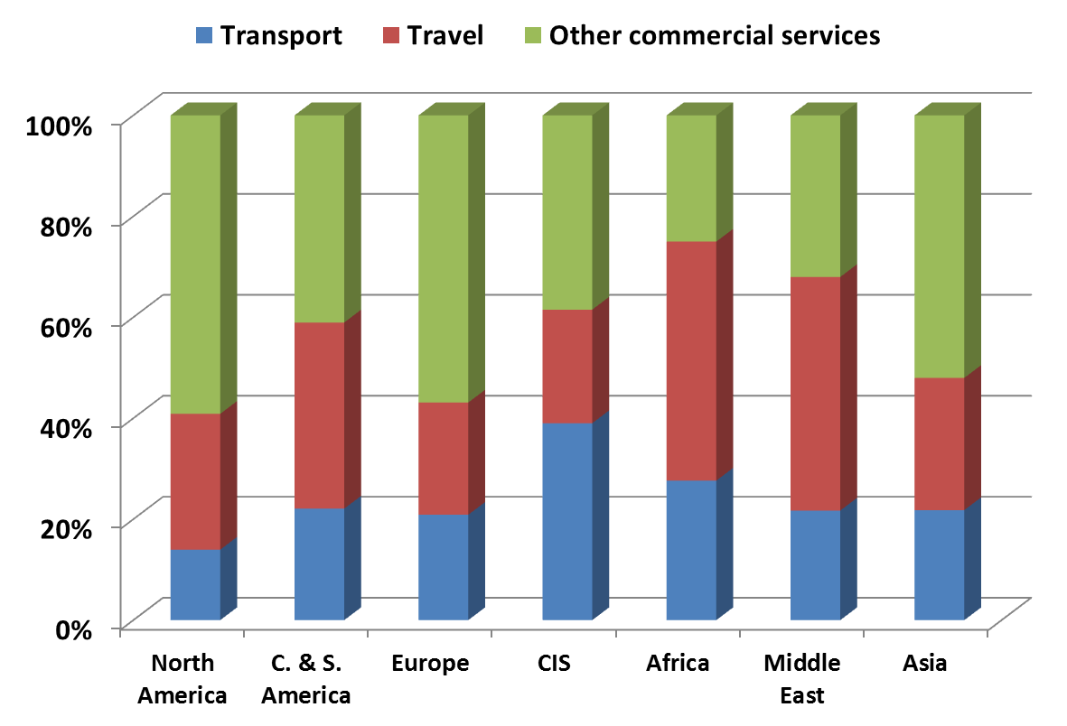
Structure of Commercial Services Exports
by Region, 2017

Slide 20
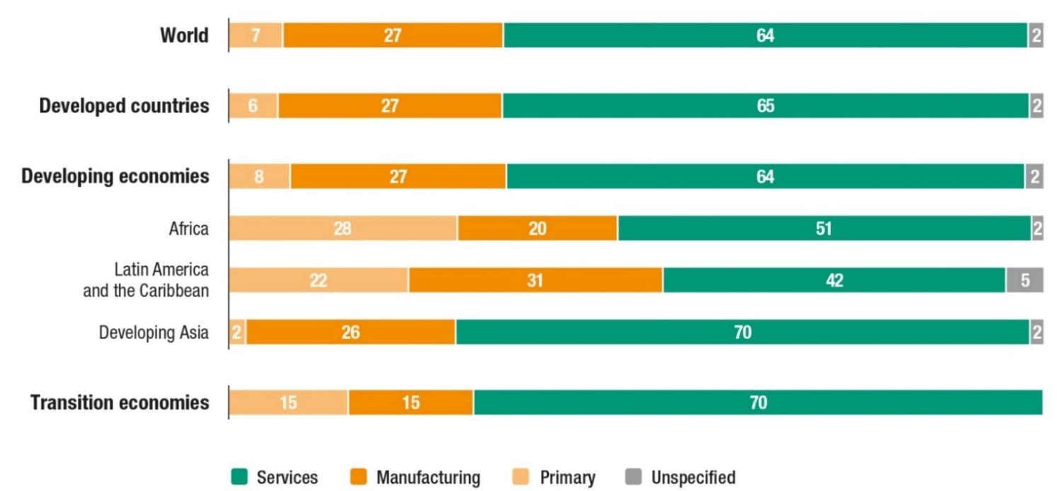
Services are the main destination for global FDI
Global inward FDI stock, sectoral distribution by grouping and region (Per cent)
Source: UNCTAD.
Global and Regional Investment Trends

Slide 21
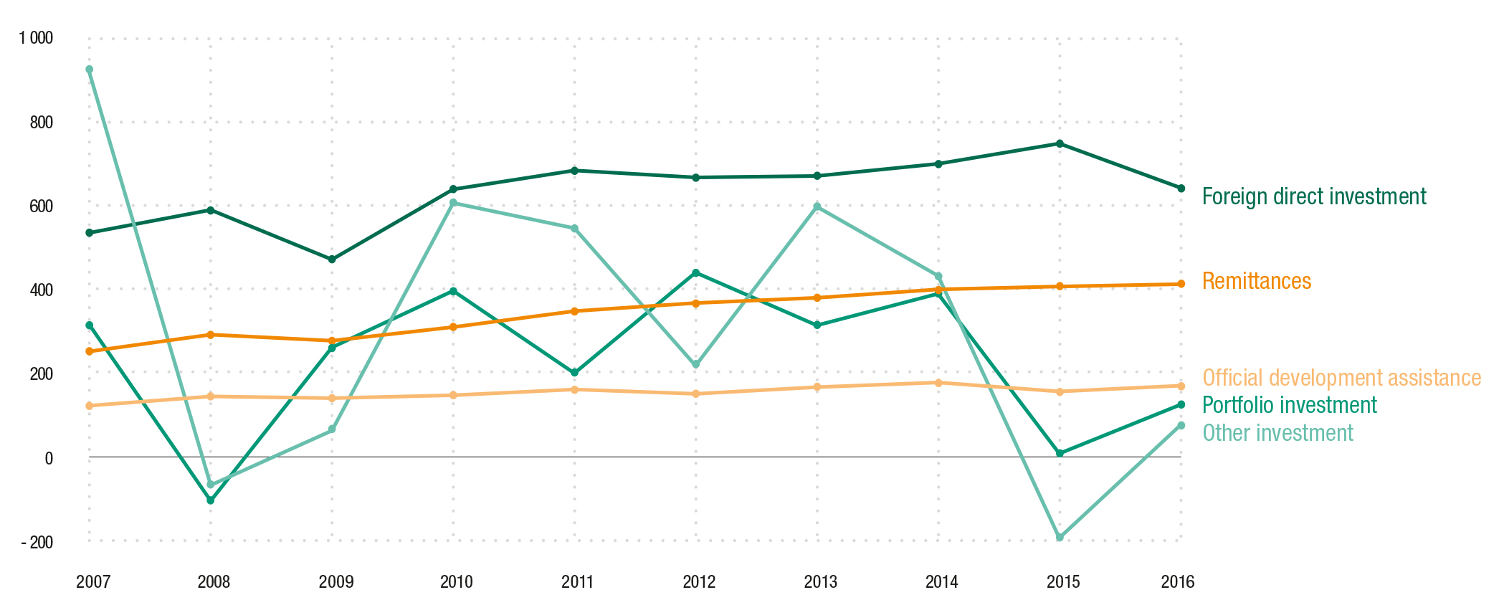
FDI remains a key source of finance for developing economies
External sources of finance for developing economies, 2007–2016 (Billions of dollars)
Source: ©UNCTAD WIR 2017.
Global and Regional Investment Trends

Slide 22
Services exports are resilient
Global flows of goods and services, foreign direct investment, other financial flows and cross-border data, 1990-2015
(Index: 2003=100 and terabytes per second)

Slide 23
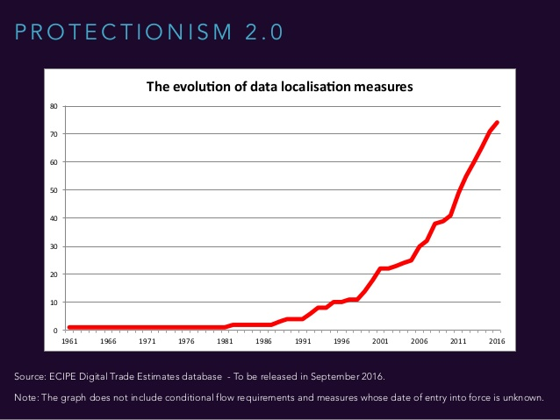
Digital protectionism is on the rise

Slide 24
Trade statistics expressed in gross (BoP) terms understate the true weight of services in world trade

Slide 25
Connecting through services
Services provide the basic infrastructure to support trade in goods
  maritime, road, air transport; wholesale and retail services; logistics and express delivery…
  The more expensive or inefficient the underlying services, the harder it is to trade goods.

Slide 26
Connecting through services
Services enable global value chains and are significant inputs in the production of goods
  About half of world trade occurs through GVCs
  Services make operation/coordination of GVCs possible
  Services value-added account for about a third of manufactured exports

Slide 27
Connecting through services
Services provide the backbone that enables e-commerce and the on-line supply of services
  E.g., telecom, computer services
  Online trade expands opportunities, increases productivity and reduces trade costs

Slide 28
Primary Manufacturing Services
Source: OECD.Stat, OECD-WTO Trade in Value Added (TiVA), December 2016.

Slide 29
Services VA in exports of manufactured products
Domestic VA
Foreign VA
Note: Figures refer to 2011.
Source: Based on OECD-WTO TiVA database, June 2015

Slide 30
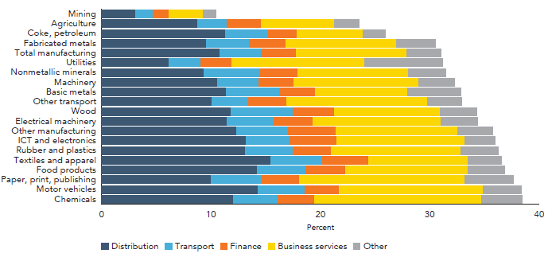
Services value added in world gross exports, by manufacturing industry, 2015
Source: Heuser/Mattoo 2017, sourced from Miroudot 2016 based on OECD-WTO TiVA database.

Slide 31
Supply of Services by Mode of Supply
35%
10-15%
50%
1-2%
Notes:
31

Slide 32
The broader relevance of services
Services play a multifaceted and significant role in connecting countries to the international trading system and the global economy
Services matter greatly to economic performance and development

Slide 33
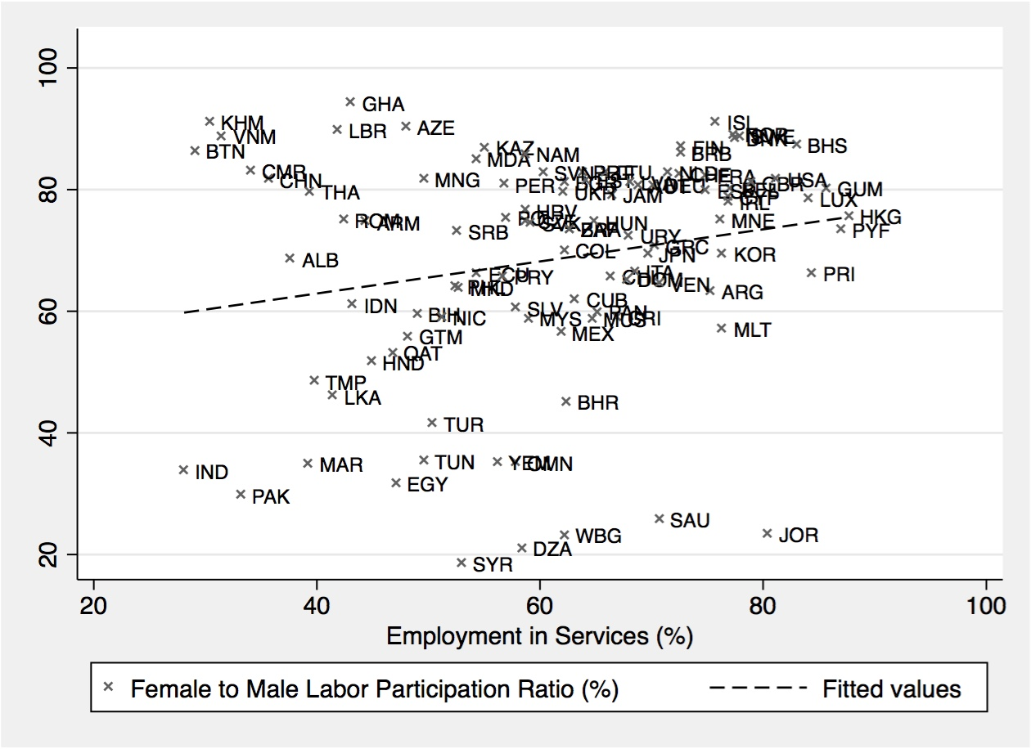
Services Trade and Gender

Slide 34
Services (Trade) Policies Matter Greatly
Barriers to trade in services are high and widespread. These barriers raise trade costs
Trade costs in services can be higher than for goods, especially for Modes 1 and 4.

Slide 35
Average 2016 STRI by region
WB/WTO Services Trade Policy Database

Slide 36
2016 STRI by region and sector
WB/WTO Services Trade Policy Database

Slide 37
Services (Trade) Policies Matter Greatly
Services trade openness/restrictiveness affects economic performance and connectivity. For example, restrictions limit…
  The productivity of manufacturing industries and exports of manufactured products
  Inward foreign investment
  the development of digital infrastructure
    competitive markets had mobile broadband penetration rates 26.5% higher
  Physical connectivity

Slide 38
Sectoral coverage of GATS commitments, July 2016

Slide 39
Proportion of Acceding Members with Commitments in Selected Service Sectors
39
Notes:
39

Slide 40
GATS: Country pattern of commitments

Slide 41
Nature of GATS Market Access commitments (all Members)
41
Notes:
41

Slide 42
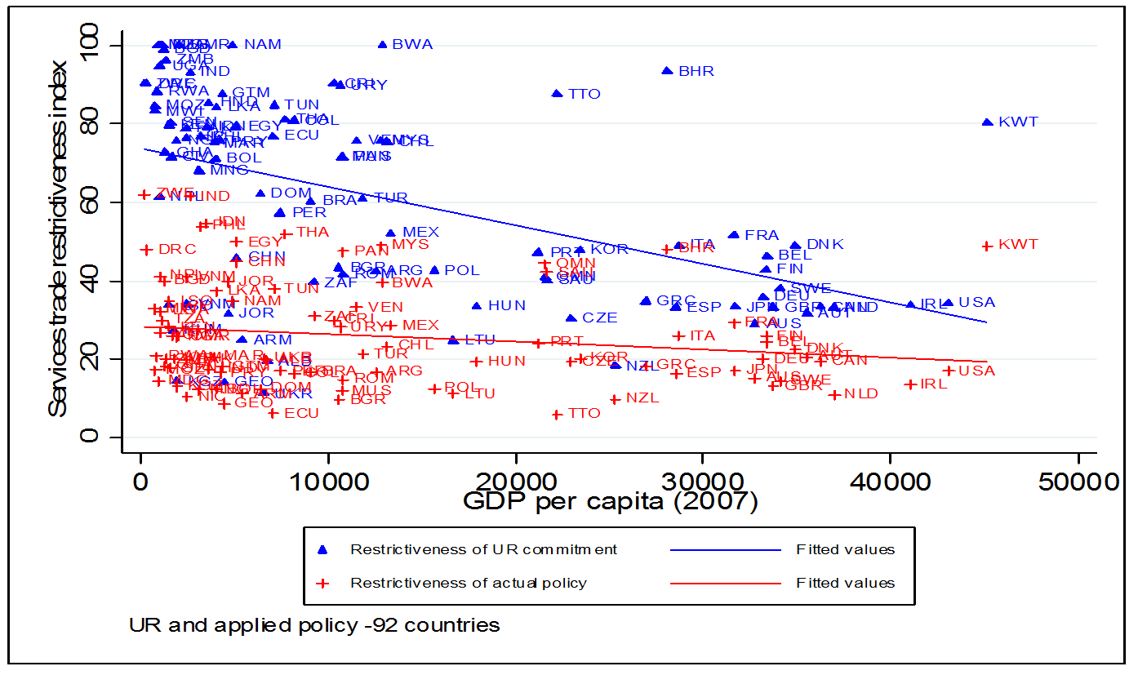
GATS commitments vs. regulatory status quo
Gootiiz and Mattoo (2009)

Slide 43
Negotiating issue | Treatment in GATT | Treatment in GATS
Modes of supply | Cross-border ; limited coverage of investment matters (TRIMs); no inherent need for factor mobility in goods trade | Inherent need for addressing factor mobility in services trade; reliance on four modes of supply: cross-border supply; consumption abroad; commercial presence; movement of natural persons
Quality of data, measurement, modelling | Comprehensive, disaggregated robust | Partial, aggregated, weak Problematic for emergency safeguard determination
National treatment | General obligation, no exceptions | A la carte in scheduled sectors and modes, subject to limitations; right to not schedule
Most-favoured nation treatment | General obligation without exception | General exception subject to one time exception upon GATS’ entry into force or accession; with a weak/non-credible sunset clause
Quantitative restrictions | Prohibited; per se offense | Allowed, subject to listing in scheduled sectors and modes
Diversity | One size fits all; common rules to all sectors subject to goods disciplines | Co-existence of horizontal and sector-specific disciplines in annexes
43

Slide 44
PTAs: State of Play

Slide 45
Notifications:
PTAs covering trade in services
Total: 152
45

Slide 46
Level of Development of Parties to Services PTAs
47%
But since 1/1/2016: two-thirds of services RTAs are ‘south-south’.
46

Slide 47
Motivations for Services PTAs
Politics; Negotiating Economy
To reflect new ways of doing business; advancing new rules
Security of access for services exporters; GATS+ commitments/Reciprocity
Different liberalization modalities
Regional integration
Encourage and consolidate reforms
Investment signalling; improving business climate
Part of trade-offs for preferential access in goods or other issues (e.g., development assistance; labour mobility)
Bandwagon effect

Slide 48
How much GATS +?
Assessing Commitments in
Services PTAs

Slide 49
Key Trends: Sectoral Coverage
49
Source: Roy (2011), updated from Roy, Marchetti and Lim (2007)

Slide 50
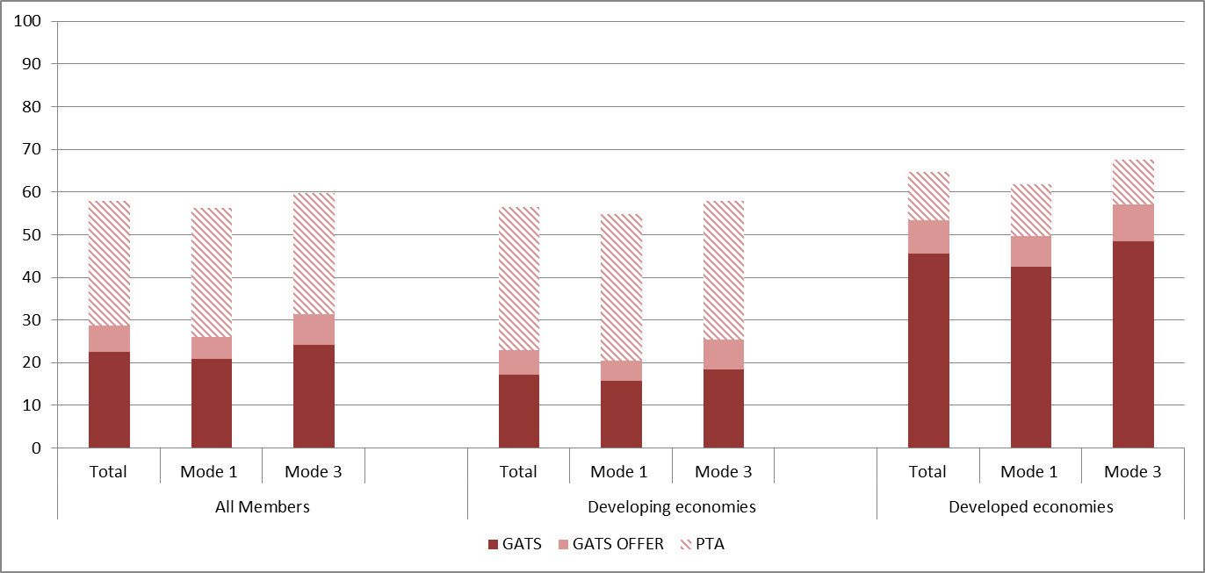
Index: Overall Trends
50
Source: Roy (2011), updated from Marchetti and Roy (2008) on the basis of expanded dataset.

Slide 51
Thank you
psauve@worldbank.org

